Slide 1
B3 Program Updates and Energy Efficient Operations Overview
MNCEG Annual Conference 2018
Garrett Mosiman
mosi0019@umn.edu

Slide 2

B3 History in Minnesota
Hennepin County Sustainable Building Guidelines developed in 1995.
The B3 Sustainable Building Guidelines were established in 2004 for all new state-bonded projects.
B3 Benchmarking was established in 2004 to track all public building energy use in Minnesota.
The B3 Guidelines were updated in 2008 to include all substantial renovations.
The original energy requirement in the B3 Guidelines was 30 percent below the State Building Code. This was replaced by the Energy Standard from the SB 2030 program in 2009.
Notes:
John

Slide 3

B3 History in Minnesota
The purpose of the program was to make the guidelines “performance based” so each project team could determine the most cost effective method of obtaining the objective
The guidelines were designed to be connected to real outcomes
The guidelines were to reflect the environmental issues of Minnesota and attempt to address these issues
  Energy reduction and bldg. commissioning
  Water reduction and pollution
  Indoor Air Quality
  Project Management/Commissioning
Notes:
John

Slide 4
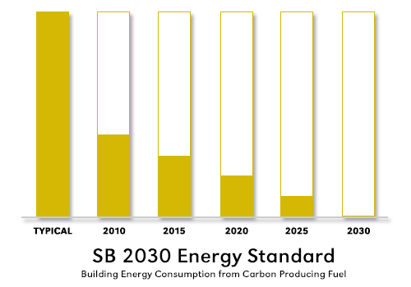
Sustainable Buildings 2030
The SB2030 initiative was passed by the Minnesota legislature in the 2008 session.
The purpose is “to establish cost-effective energy-efficiency performance standards for new and substantially reconstructed commercial, industrial and institutional buildings that can significantly reduce carbon dioxide emissions by lowering energy use ...”
These standards have become the energy use requirements for state-bonded projects through the B3 Guidelines (formerly Minnesota Sustainable Building Guidelines).
Notes:
John

Slide 5
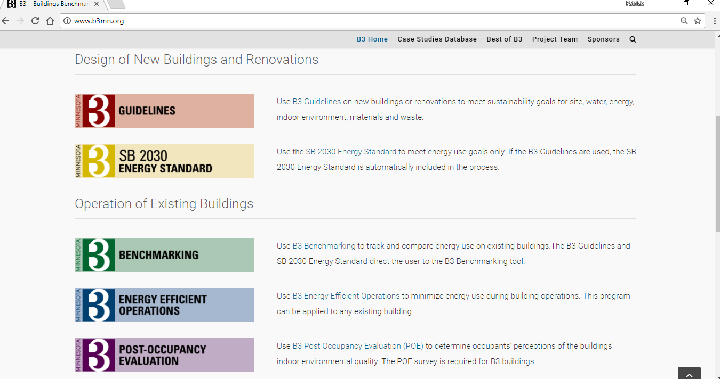
B3MN.org
Notes:
John—Beginning of new features section--This is where we show the new web site and note that there are new features in all the programs

Slide 6



Network of B3 Programs
B3 Guidelines
  Around 300 projects in B3 Guidelines (including SB2030 projects and older operations-only)
SB2030 Program
  Over 90 projects submitting design EUIs
  Estimated savings of 534 million kBtus/year
  Estimated savings of $8.3 million per year
B3 Benchmarking
  Over 7,500 buildings representing over 300 million SF in program
  Identified over 1,500 buildings that would be good candidates for improvement (18% of the population)
  Savings of 1,850 million kBtu per year
  Potential Savings of 23 million dollars per year
Notes:
John

Slide 7


Network of B3 Programs
Energy Efficient Operations
Development of a Building Operations Protocol
Required for some B3v3 projects
Development of new software tool modules for managing energy-efficient operations tasks
Post-Occupancy Evaluation
Required on B3 projects (if we support that building type)
Development of an on-line POE Survey
Additional levels available

Slide 8
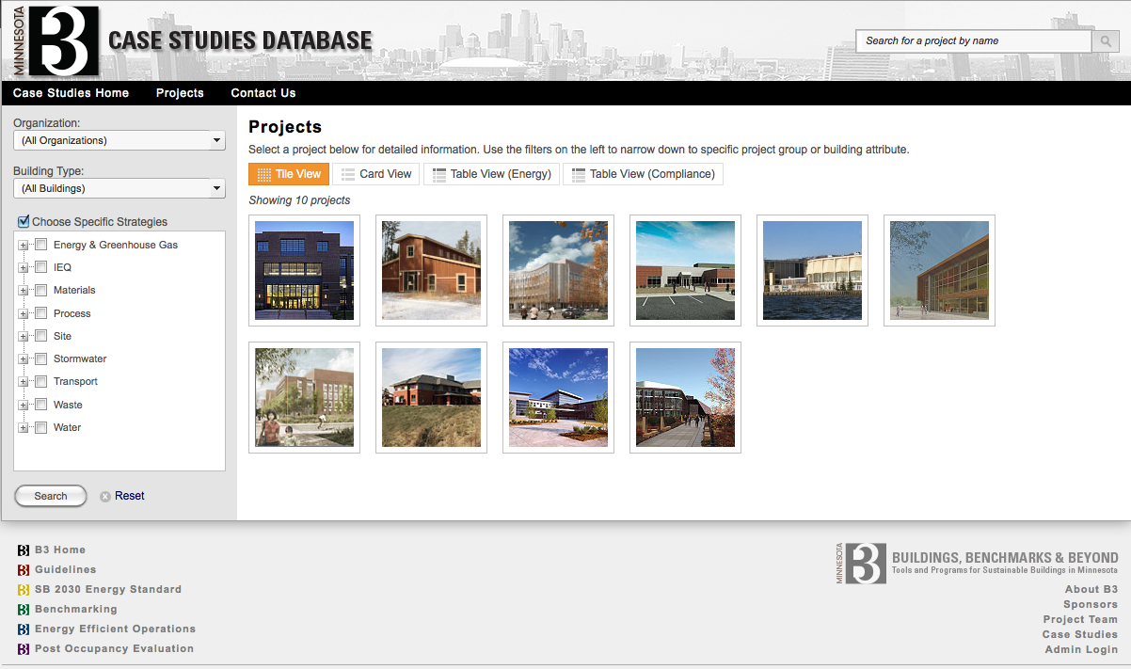
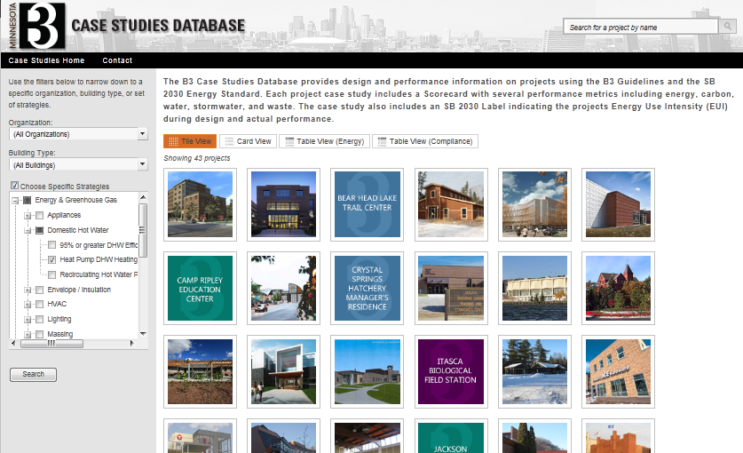
CASE STUDY DATABASE
Notes:
John—end of what’s new section

Slide 9
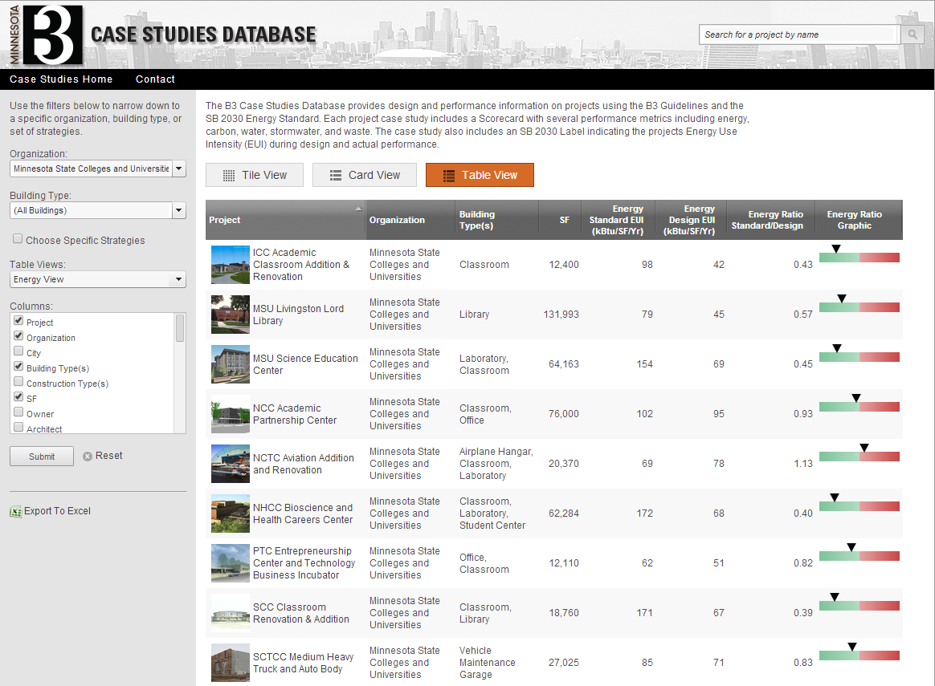

Slide 10
B3 Guidelines Tracking Tool
Key Steps
Transition to Operations
  When the B3 Tracking Tool has completed the last Design phase
  Tracking tool is ready to be converted from Construction Mode to Operations Mode
  Project is automatically entered into the B3 Benchmarking tool to set monthly energy targets and track monthly energy consumption
Notes:
Tom

Slide 11
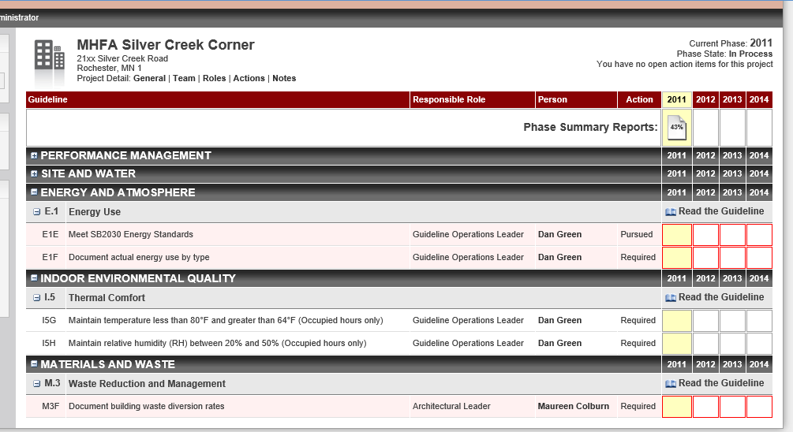
B3 Guidelines Tracking Tool
Notes:
Tom

Slide 12
Key Steps
USE OF B3 BENCHMARKING TOOL
Set the design model consumption goal by month
Enter actual monthly consumption by metered fuel type
Compare design goal to actual consumption
Investigate building systems and operational assumptions if actual energy consumption is higher than the design goal
Notes:
Tom

Slide 13
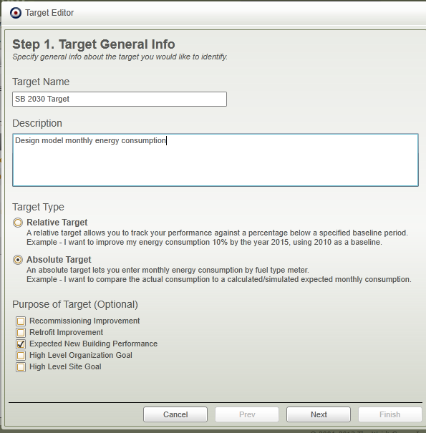
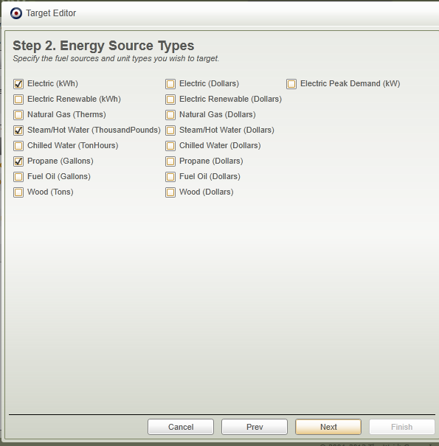
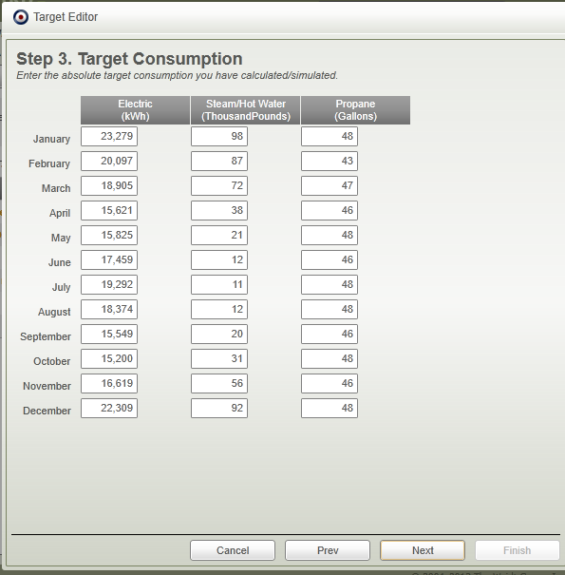
Enter SB 2030 Design Targets
Notes:
Tom

Slide 14
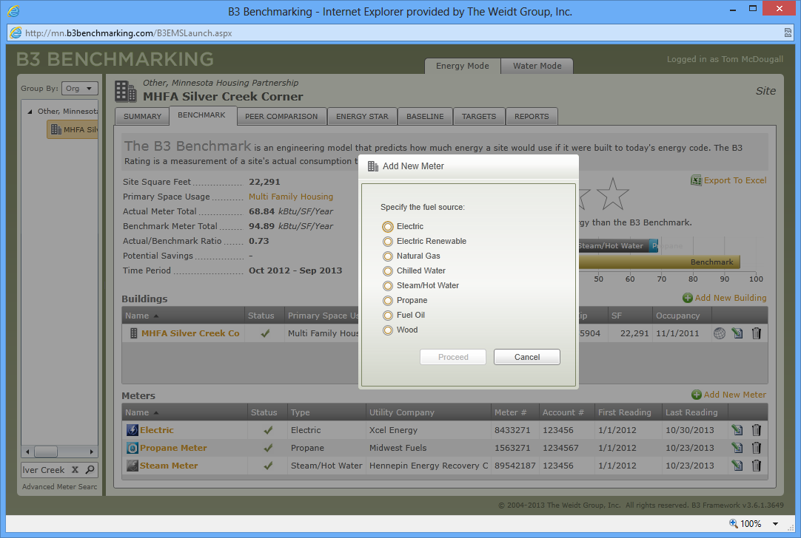
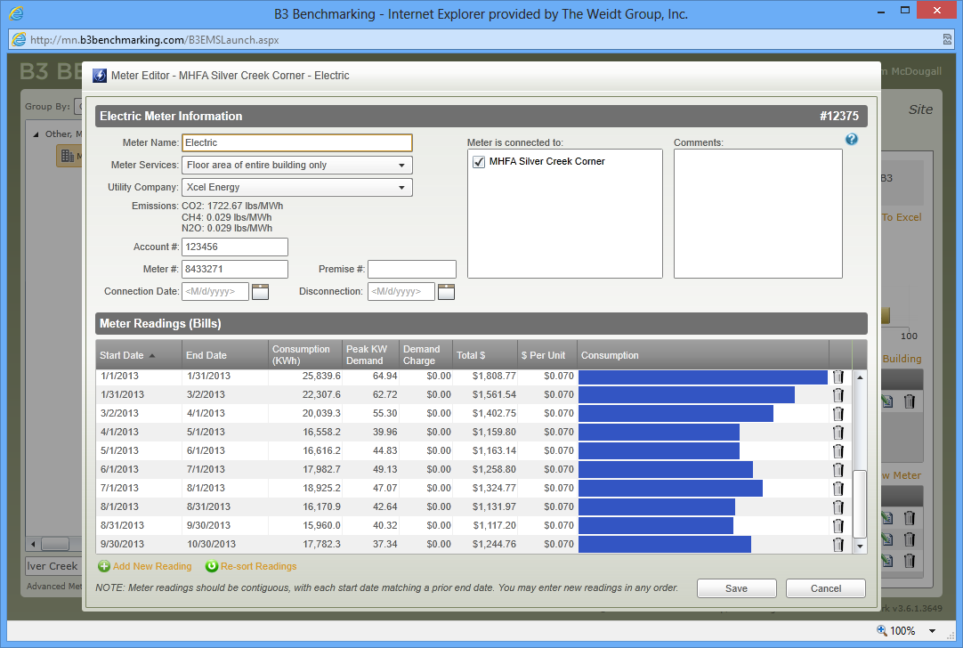
Enter Actual Consumption
Notes:
Tom

Slide 15
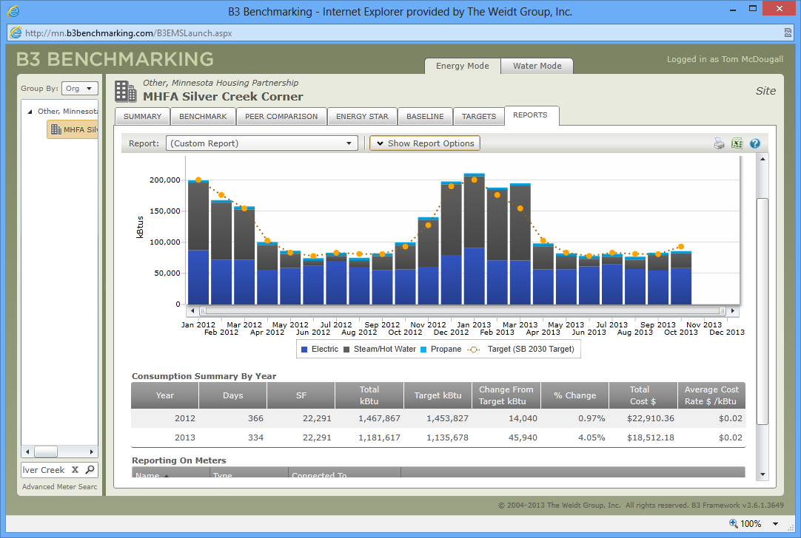
Compare Monthly Performance
Notes:
Tom

Slide 16
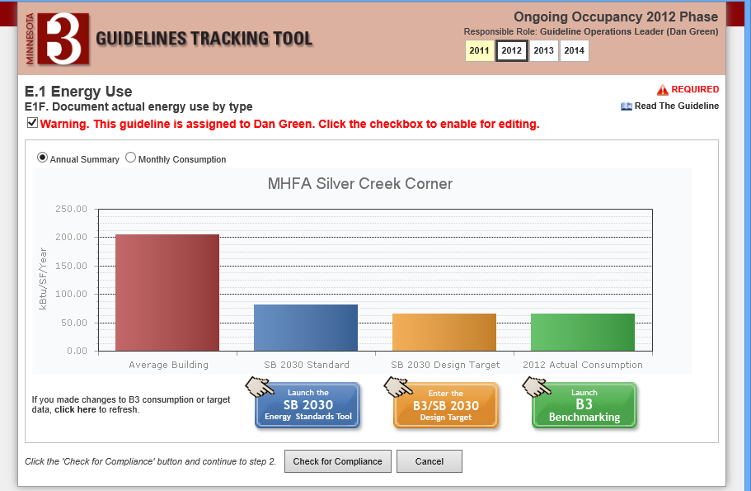
TRANSITION TO OPERATIONS Complete
Notes:
Tom

Slide 17
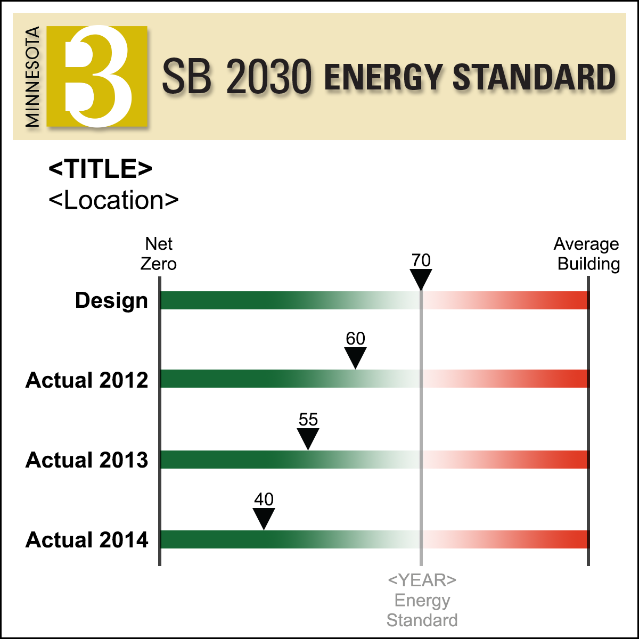
SB 2030 LABEL after Year One Operations
Notes:
Tom

Slide 18
New Feature Highlights
Improvement Plan
Event Comparison Reporting
Archived Energy Documents
Export to Excel
Person Normalization
Baseline Weather Normalization
Future dates
Wastewater Treatment Plant (WWTP) normalization
E-Commerce
Security Updates
Benchmark Modeling Updates
Questions & Comments
Support@B3Benchmarking.com
952.939.1878

Slide 19
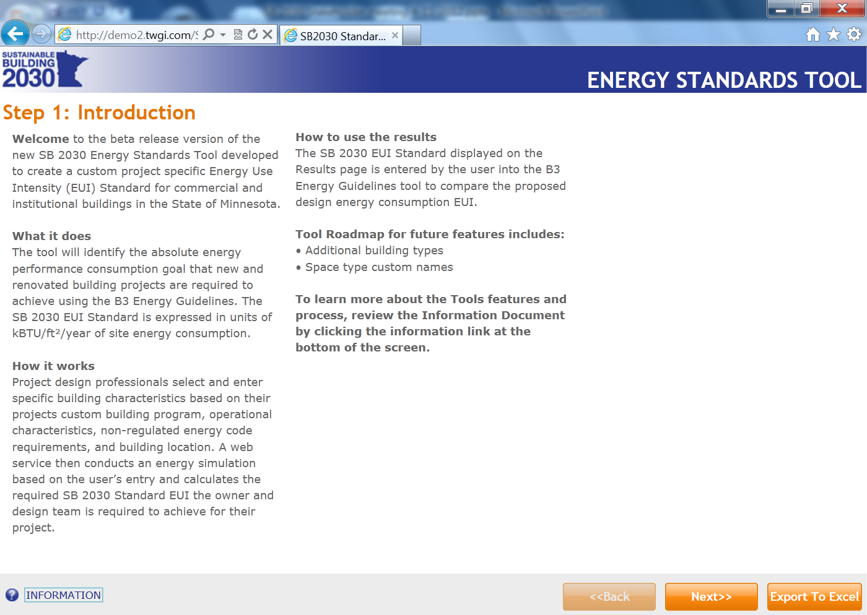
Notes:
Tom

Slide 20
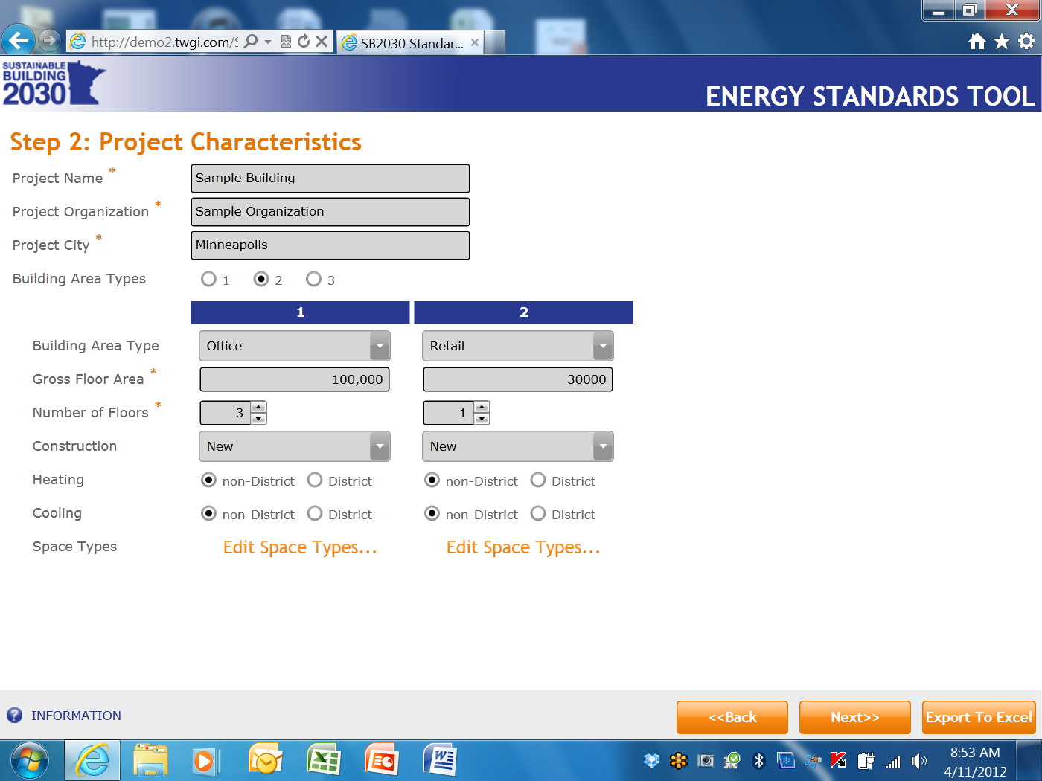
Notes:
Tom

Slide 21
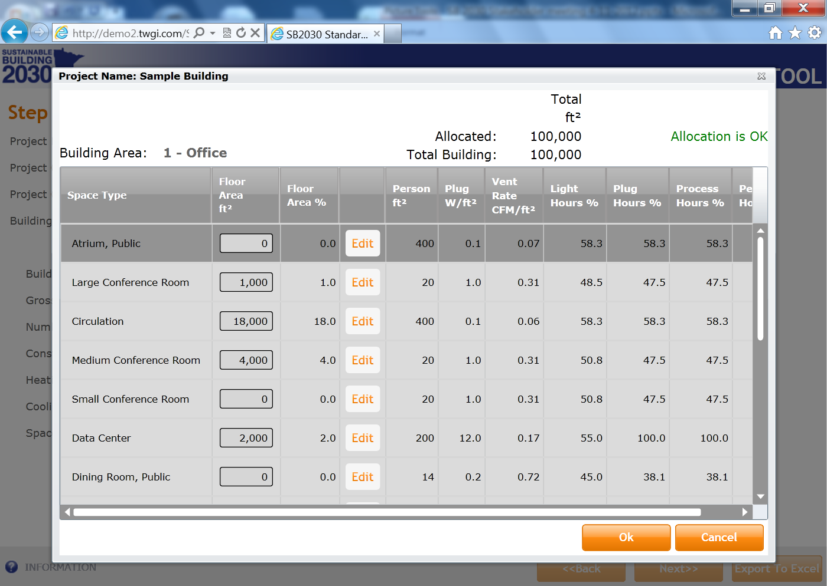
Notes:
Tom

Slide 22
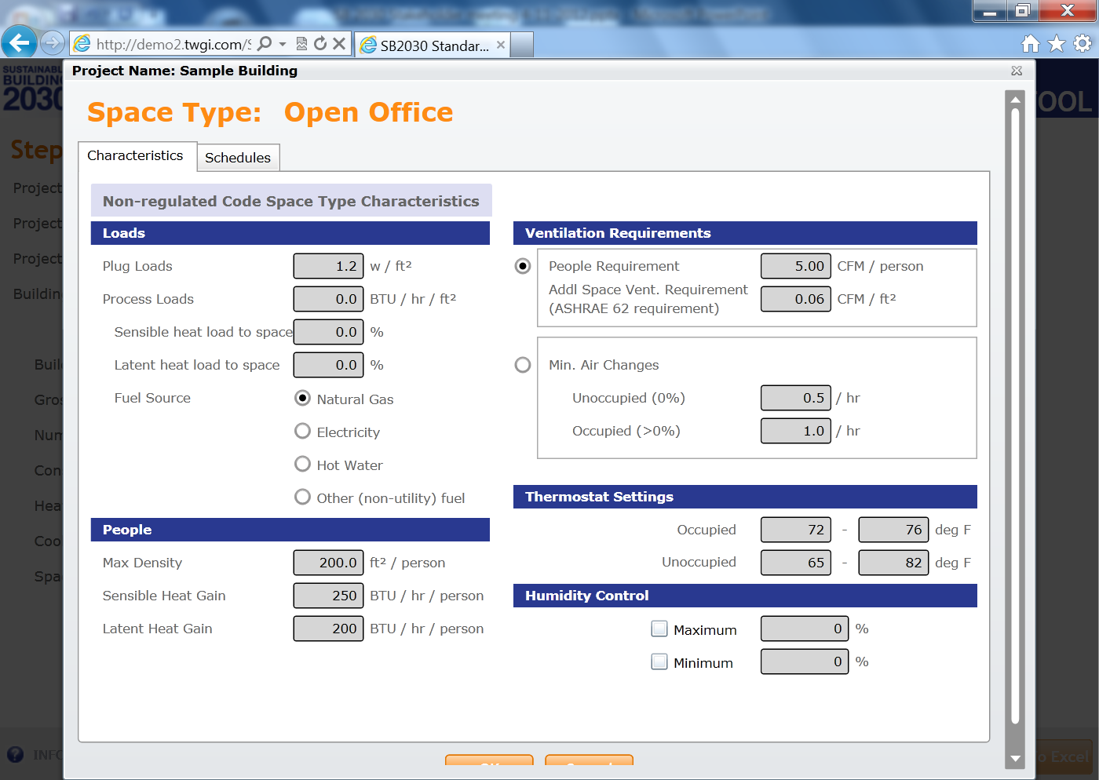
Notes:
Tom

Slide 23
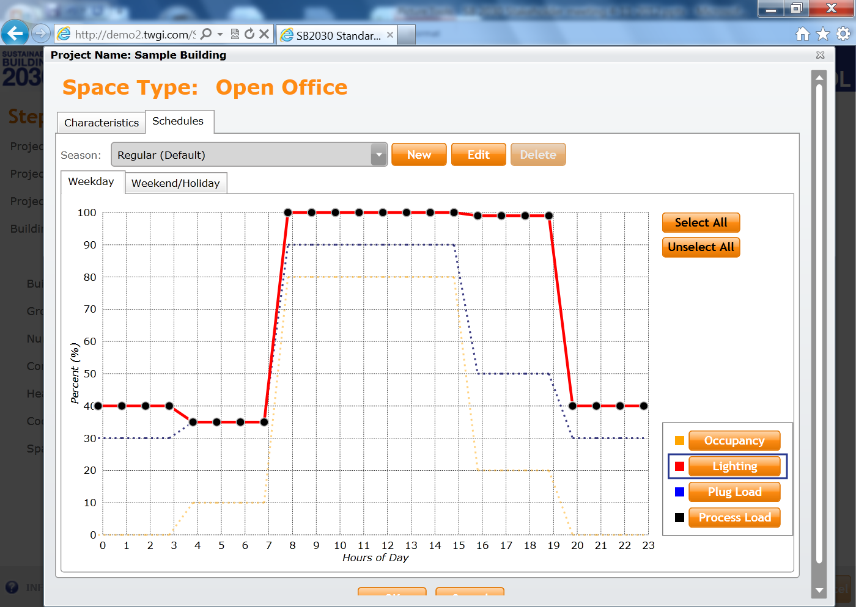
Notes:
Tom

Slide 24
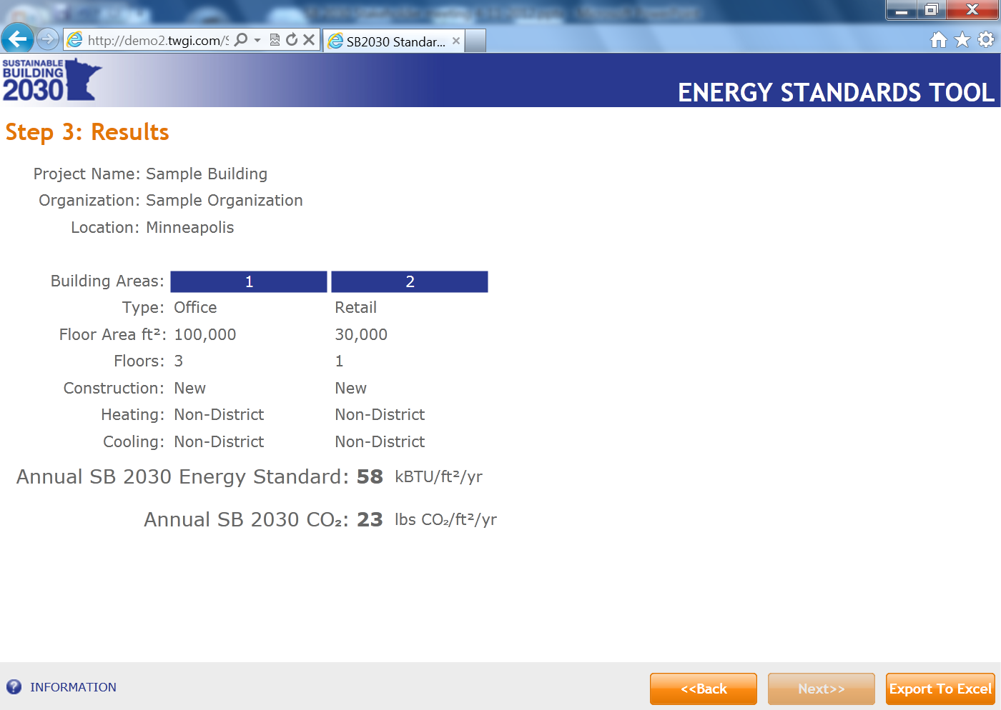
Notes:
Tom

Slide 25
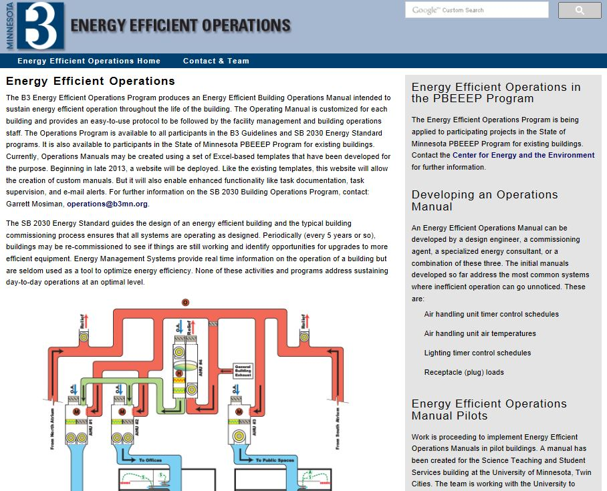
B3 Energy Efficient Operations
  A program that develops customized and easy-to-use building operations protocols to be followed by facilities management and building operations staff
  Applicability
  Useful for any building with covered system types
  Use B3 Energy Efficient Operations program to ensure continued compliance with:
  B3 Guidelines
  SB 2030 Energy Standard

Slide 26
Part 1: Background and the EEOM tool

Slide 27
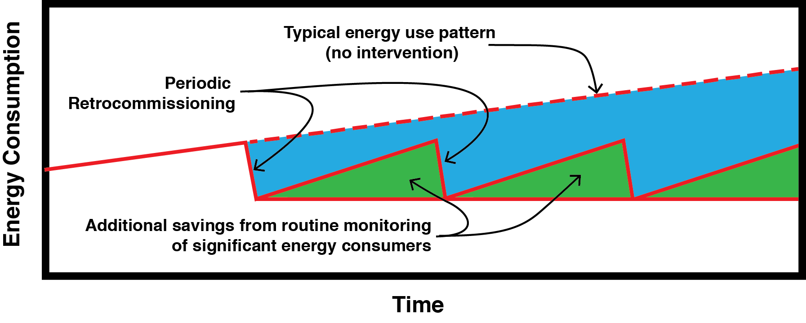
Big Picture: What are we missing?

Slide 28
Goal of Energy Efficient Operation
To ensure that each significant energy-consuming device uses only as much energy as necessary to perform its intended function.

Slide 29
Outcomes from Energy Efficient Operation
Buildings that are not routinely checking for unannounced energy waste are using 10 to 35 percent more energy than they need to.

Slide 30
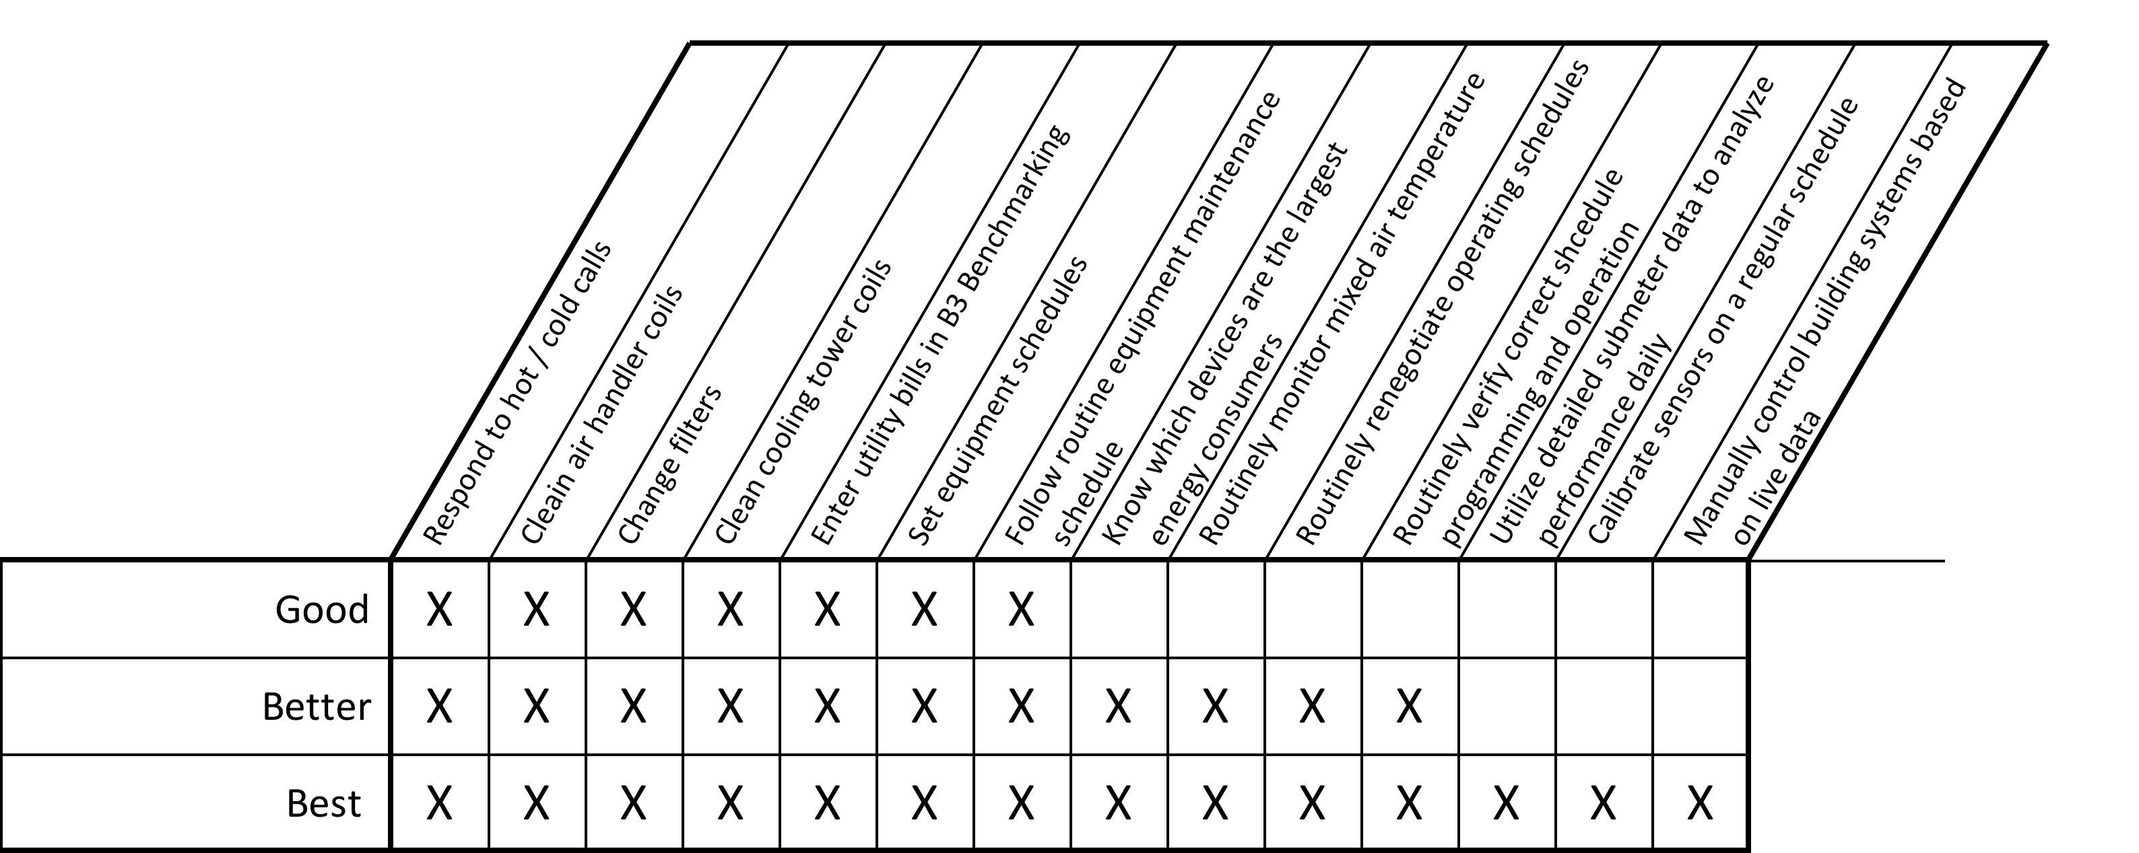
Common practice / best practice

Slide 31
Common practice / best practice

Slide 32
Step 1: An understanding of where and when significant energy waste is likely to occur is required.

Slide 33
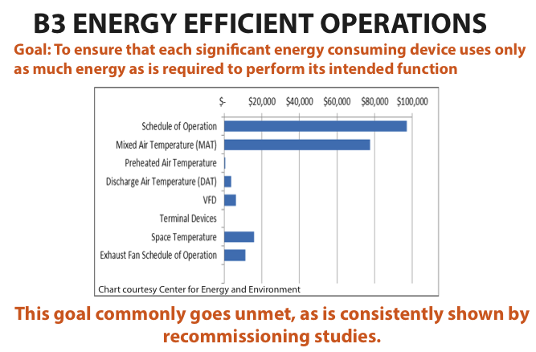

Slide 34
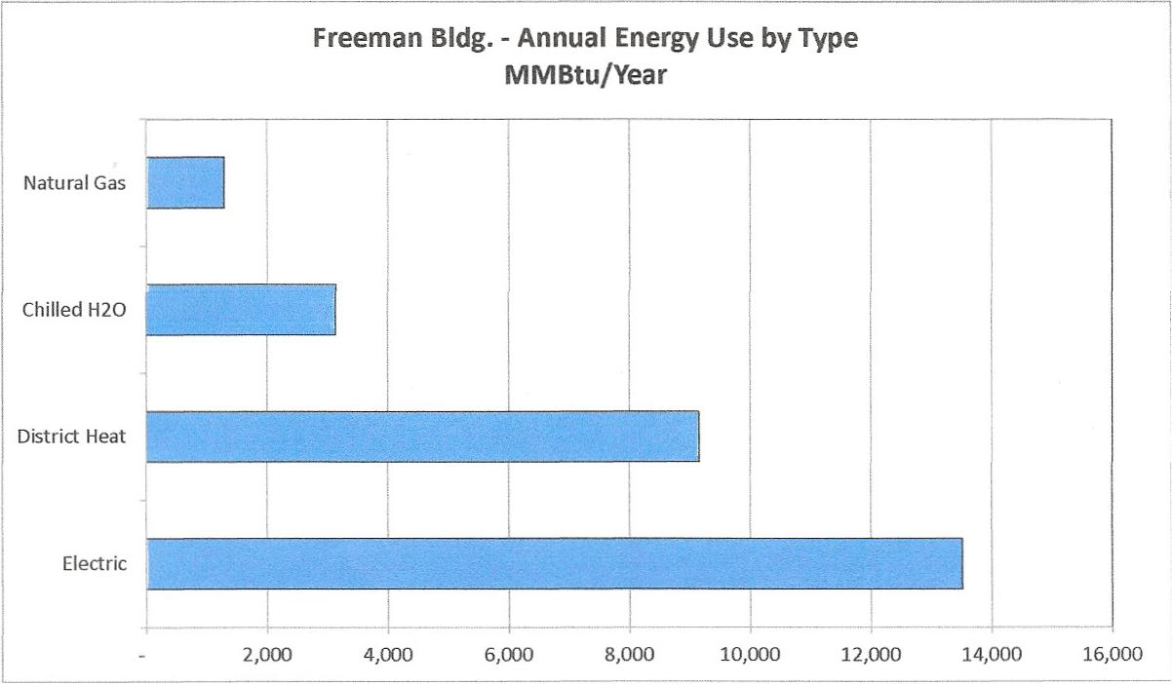
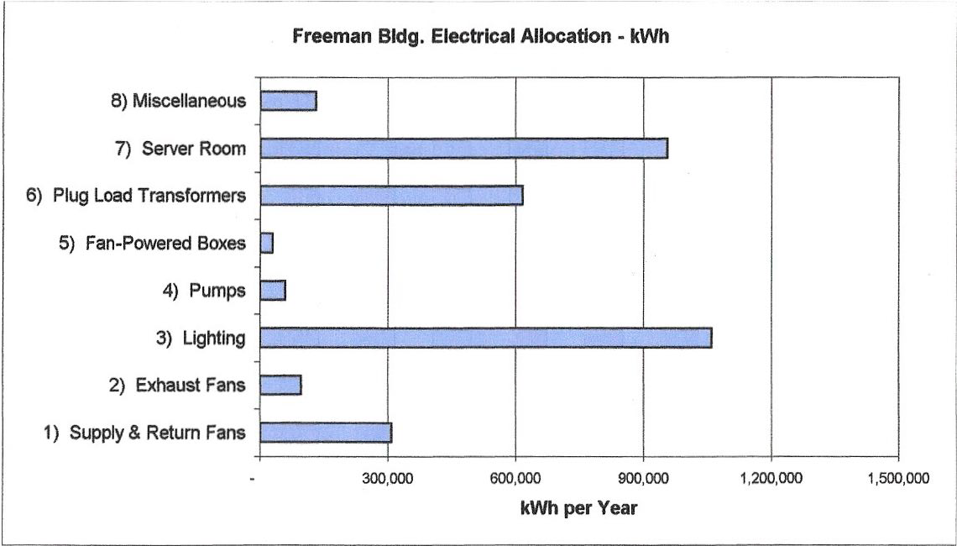
Building-specific allocation

Slide 35
Step 2: A set of tasks customized to the building that are designed to detect excess energy use is required.

Slide 36
B3 Energy Efficient Operations
Example: Incorrect Mixed Air Temperature

Slide 37
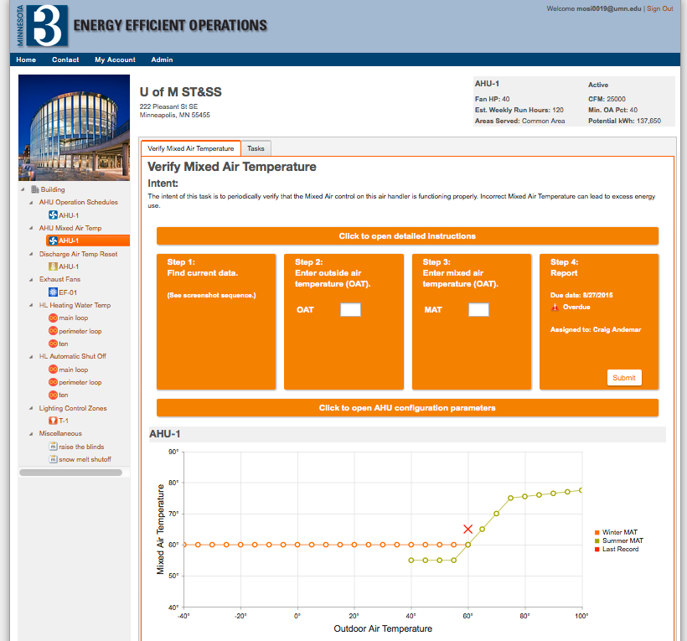

Slide 38
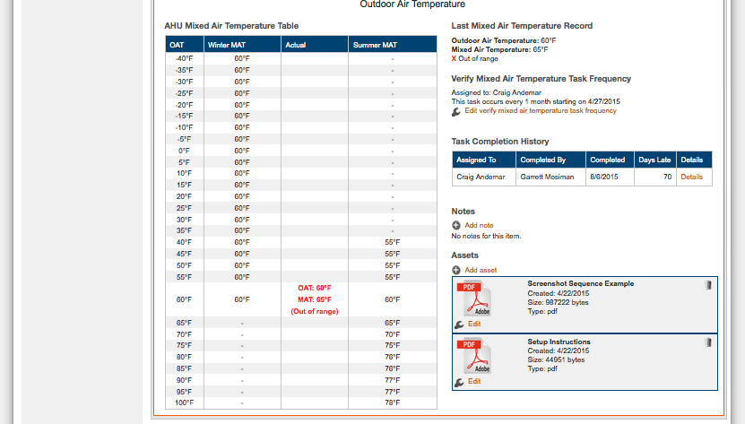

Slide 39
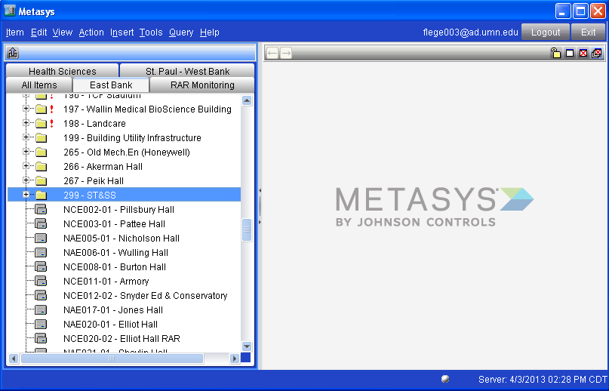
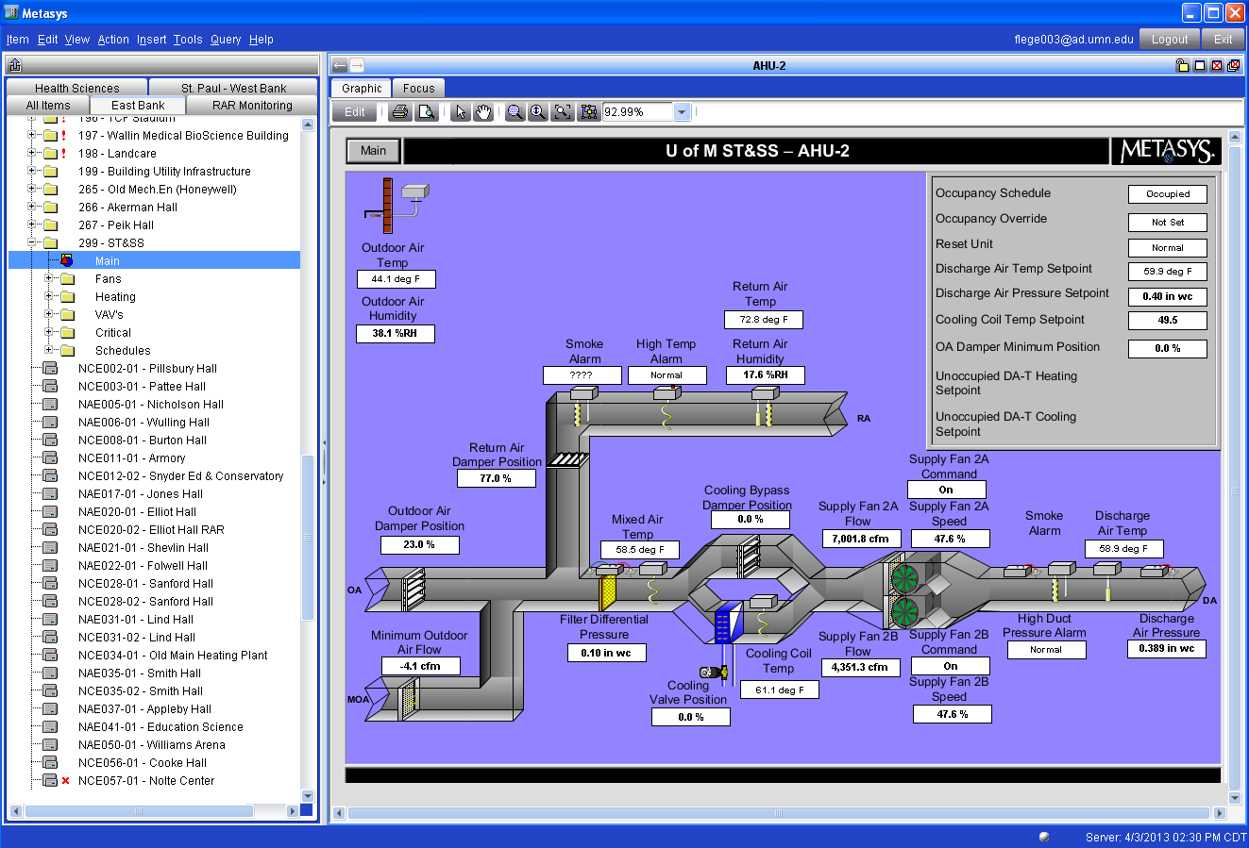
1
2

Slide 40
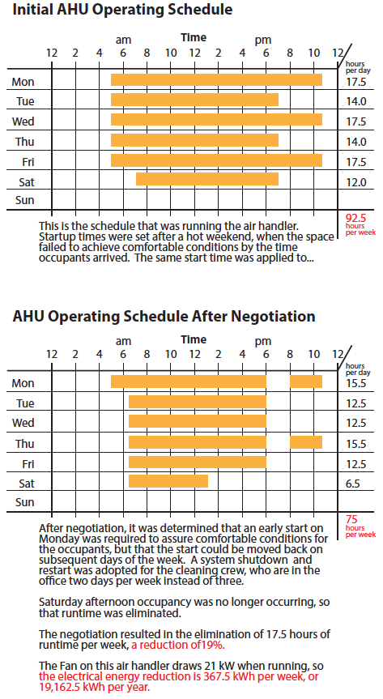
B3 Energy Efficient Operations
Example: Excessive air handler runtime

Slide 41
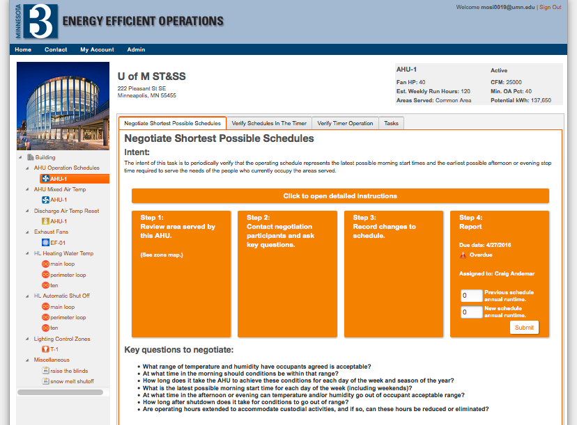

Slide 42
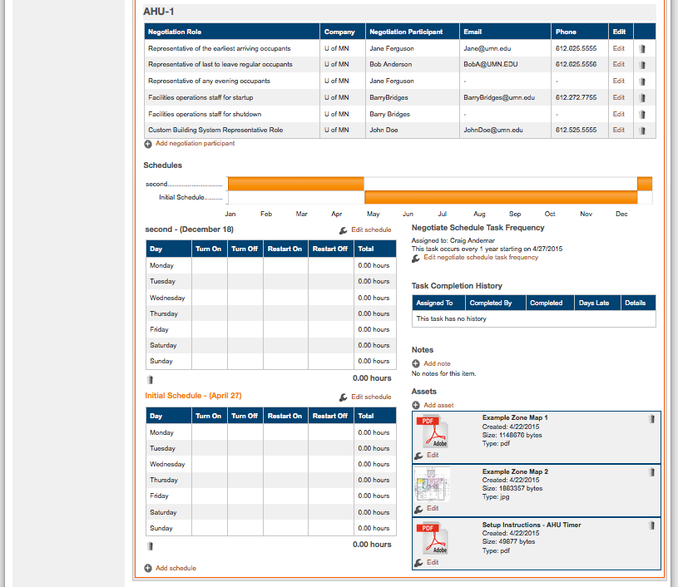
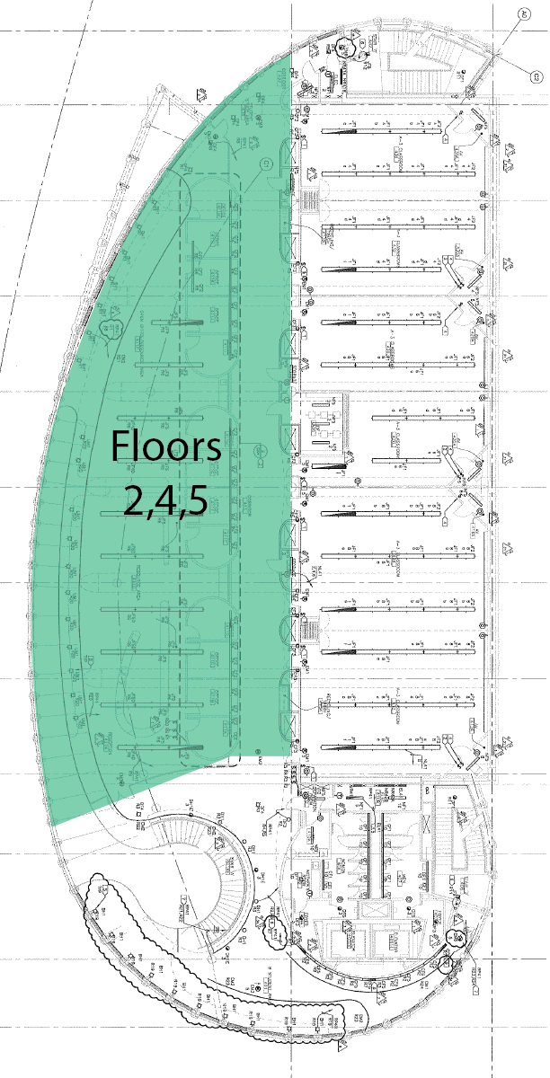

Slide 43
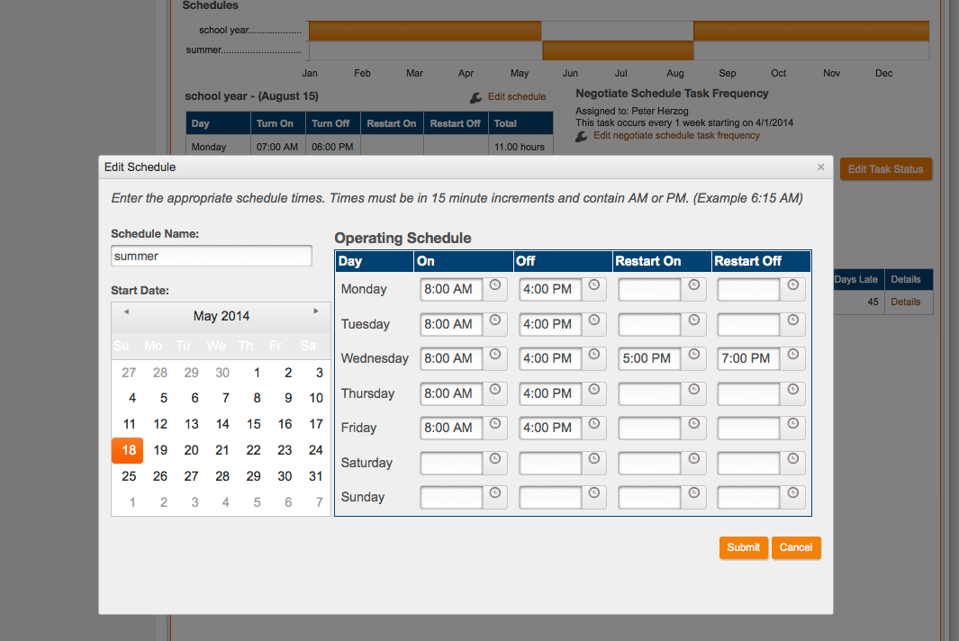

Slide 44
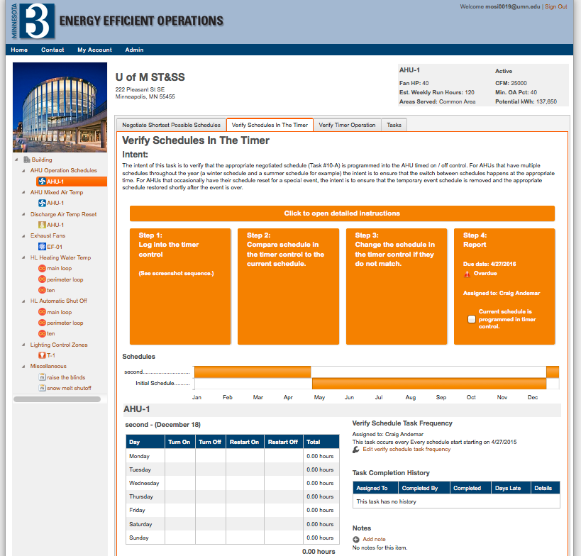

Slide 45
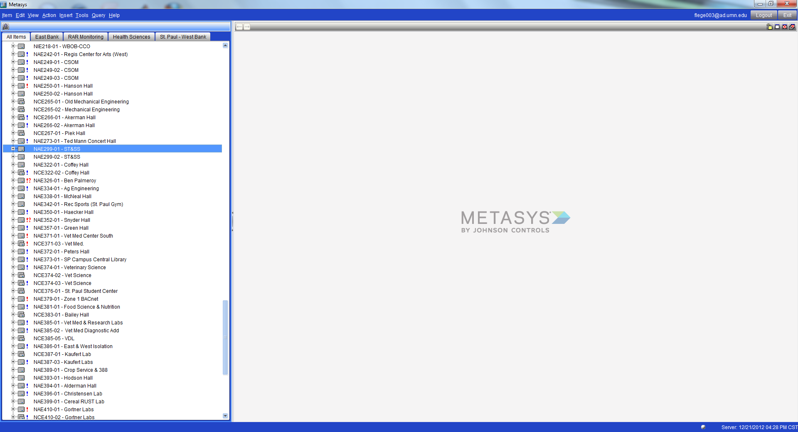
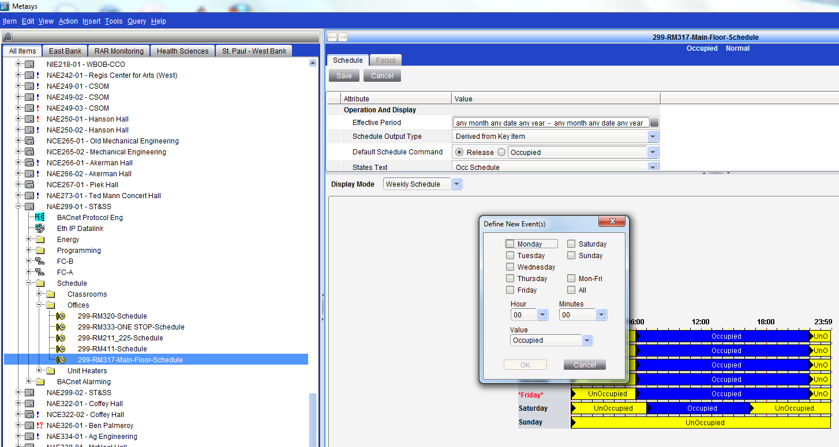
2
1
1: Scroll Down to "NAE299-01 - ST&SS"
2: Click the "+" next to the name.
9
9: Use the fields in the popup window to modify the schedule.

Slide 46
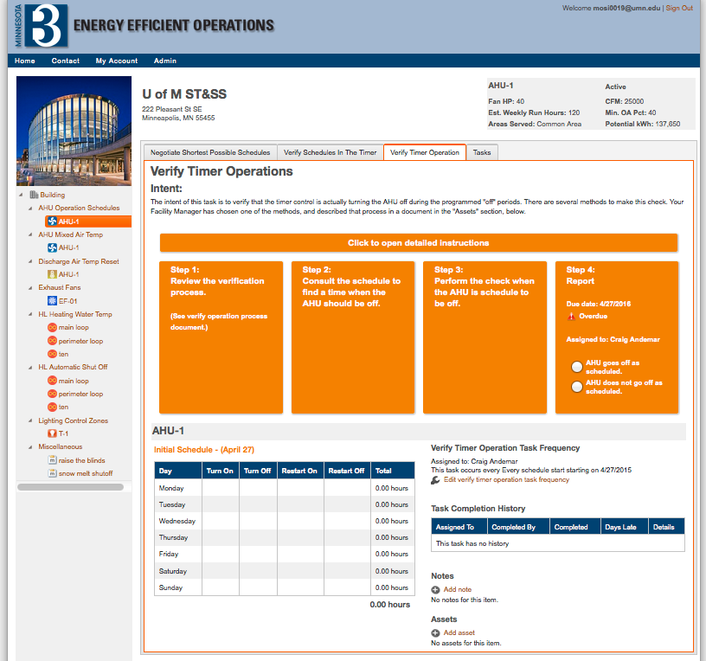

Slide 47
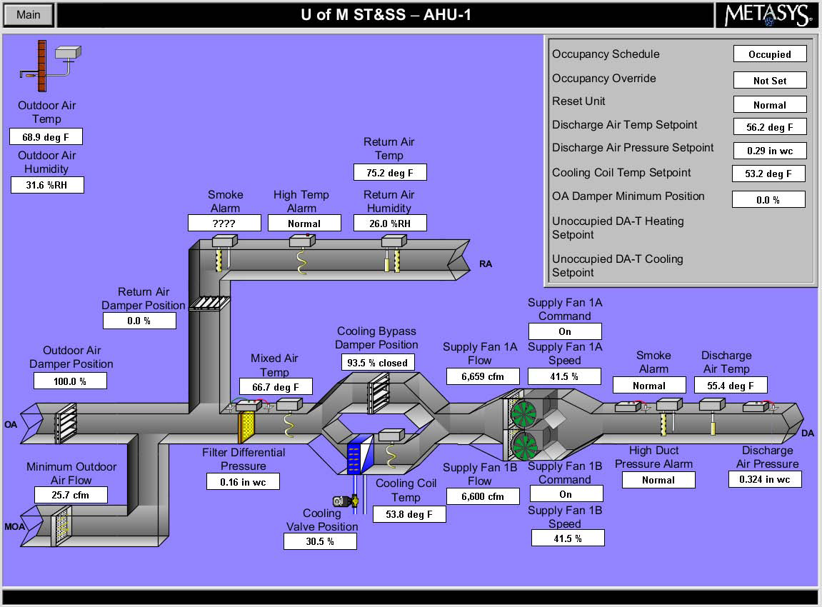
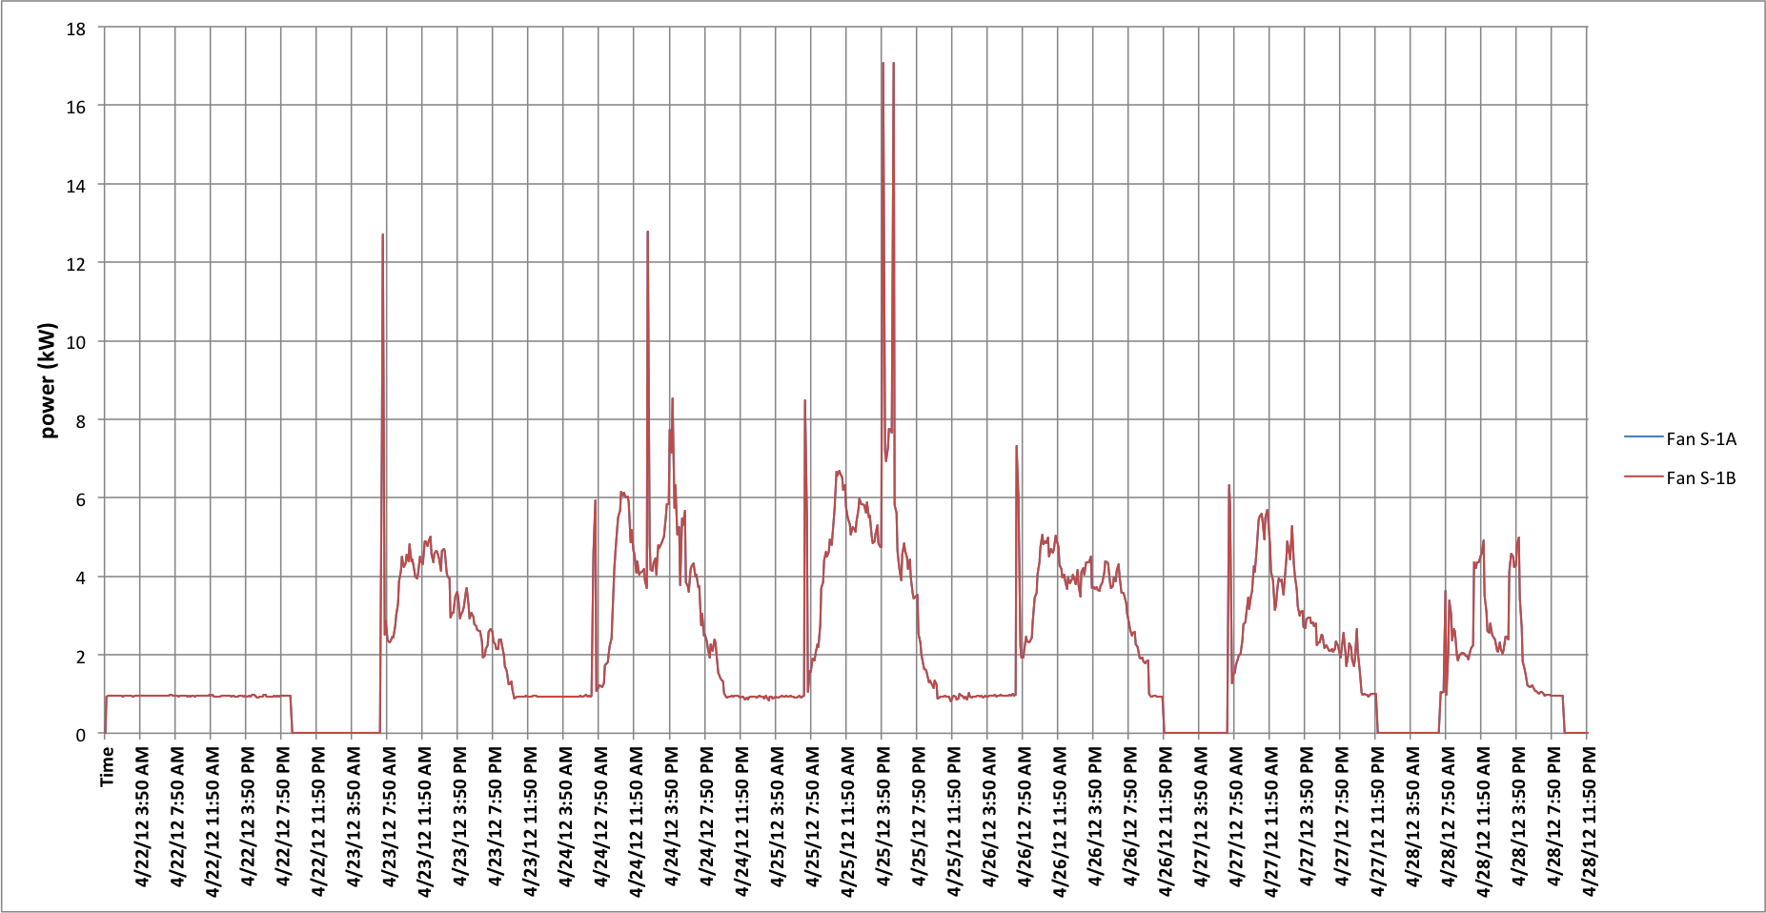
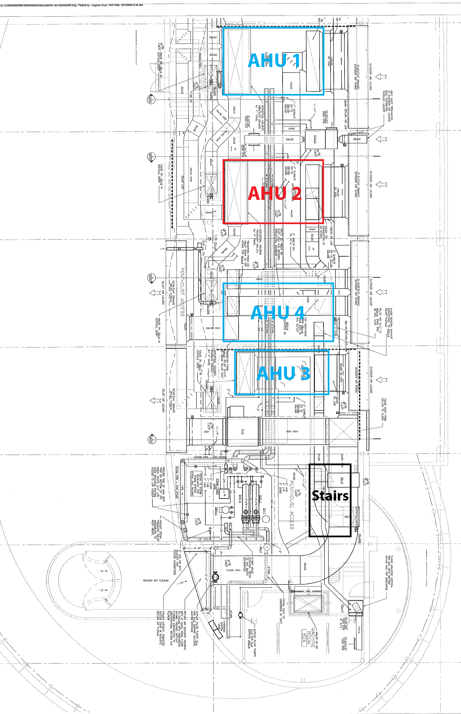
"On" Event
Malfunction indicated--
fan energy use at night
Su
Mo
Tu
We
Th
Fr
Sa
This is a floor plan of the mechanical penthouse at ST&SS, showing the location of the four air handlers that serve the building.
To confirm that AHU2 is off, go stand next to the unit and verify that:
-Fan VFD controls read zero
-No fan noise can be detected
-The cabinet of the AHU is not vibrating
If these three checks verify the unit is off, then it can be assumed the "off" control command was executed correctly.
6: Find "Supply Fan 1A and 1B Command." Verify the command is "off."
Find "Supply Fan 1A and 1B Flow." Verify the flow is below 50 cfm.
Find "Discharge Air Pressure." Verify it is below .05 in wc.
If these criteria are not all met, initiate corrective action.

Slide 48
Step 3: Regular completion of these tasks, and a capability to manage the status of the tasks, are required.

Slide 49
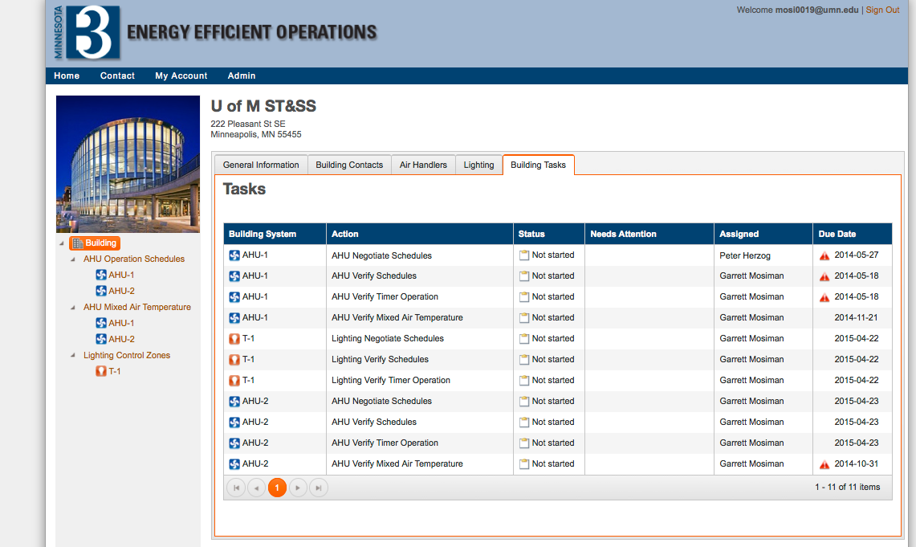

Slide 50
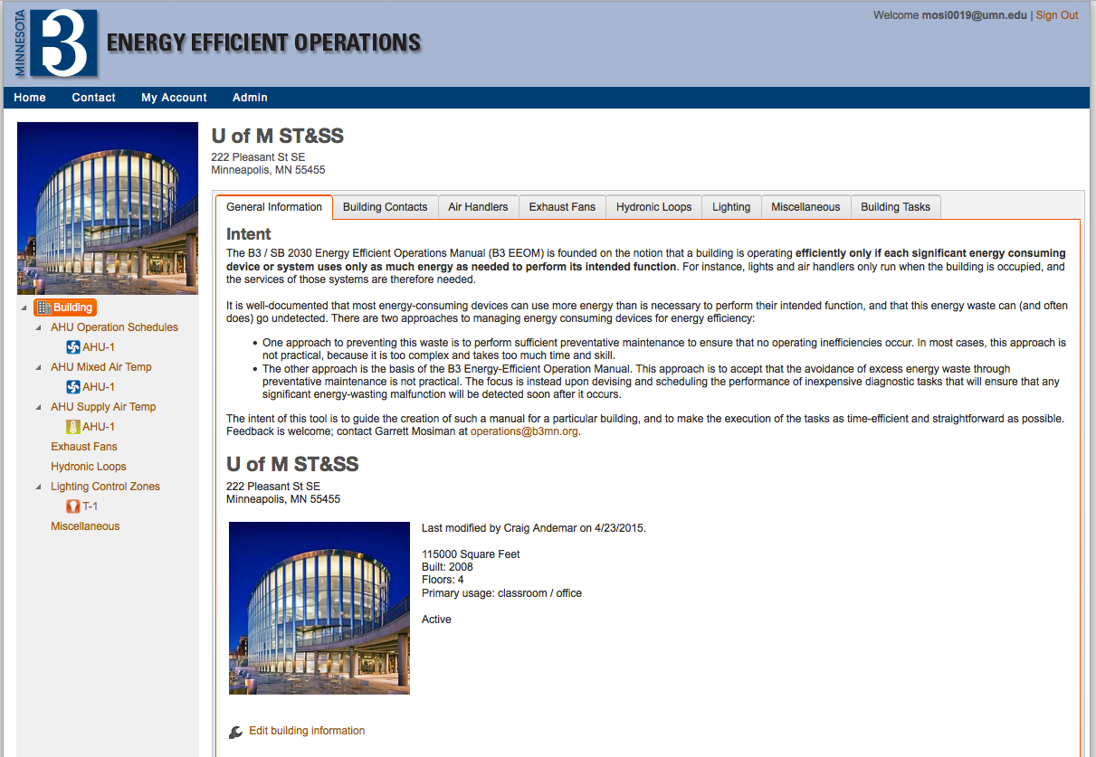
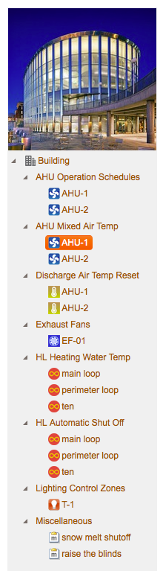
B3 Energy Efficient Operations
Web application is online, welcoming pilot buildings
  8 system checks supported, more on the way
  Automated email alerts when tasks are due
  Automated reporting to facilities manager when malfunctions are discovered
  If you have a building you’d like to pilot, contact Garrett:
  mosi0019@umn.edu

Slide 51
If you have any questions or suggestions for improvements, please contact us.
B3 Program Overall: info@b3mn.org
B3 Guidelines: guidelines@b3mn.org
SB 2030 Energy Standard: sb2030@b3mn.org
B3 Benchmarking: benchmarking@b3mn.org
B3 Energy Efficient Operations: operations@b3mn.org
B3 Post Occupancy Evaluation: poe@b3mn.org

