Slide 1
BAS Systems
Joel Seela Alexandria Tech & Community College
Randy Anderson Alexandria Tech & Community College

Slide 2
Facility diversity - controls
Pneumatic controls
Stand alone packaged
Siemens Apogee – Not supported
Automated Logic
BACNet

Slide 3
Thoughts on vendors
Own software- No license fees
Multi user simultaneous – no extra fees
Unlimited windows open
Trends stored on server, not on controllers
No limits by controller memory or version

Slide 4
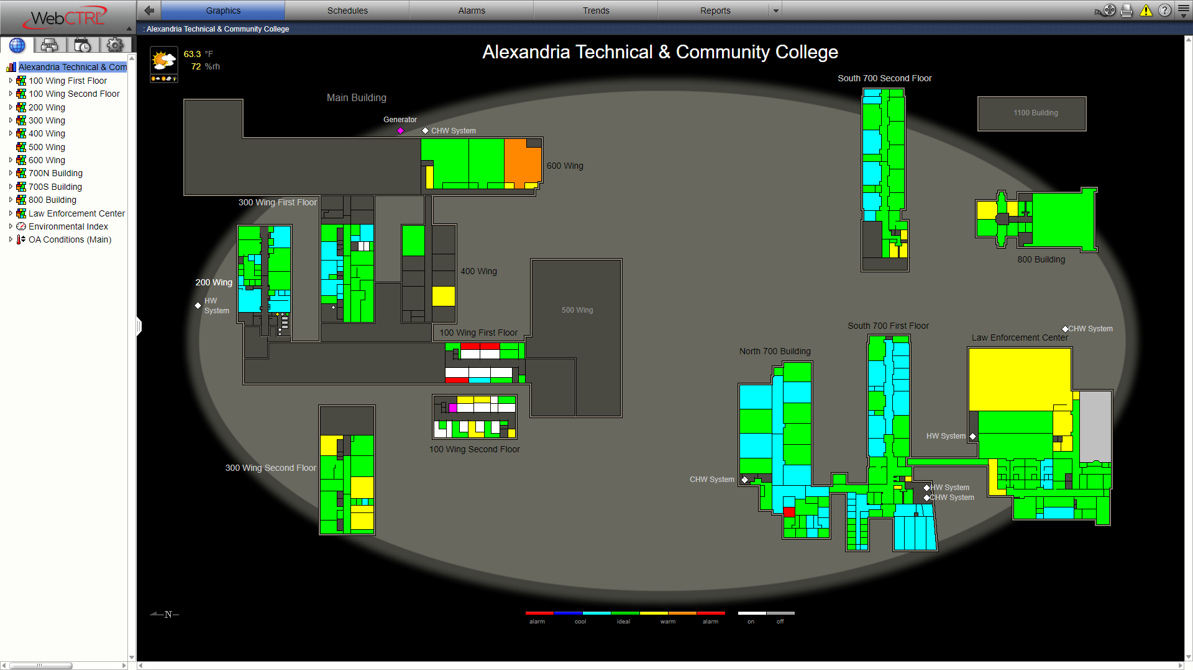
BAS Navigation
Graphical
Tree-based

Slide 5
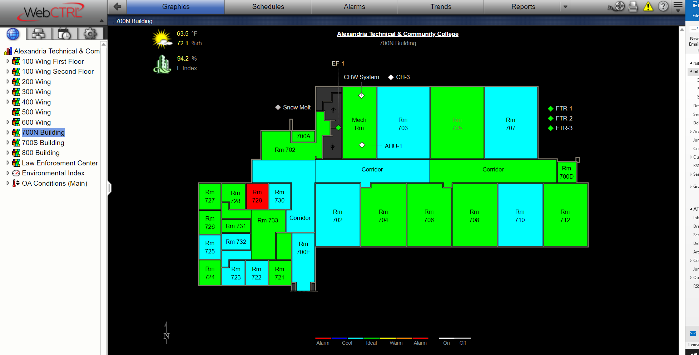
Low/High room temperature
Look at building/area lay out – Is it isolated location(small group of rooms) or a larger area (floor or building)?

Slide 6
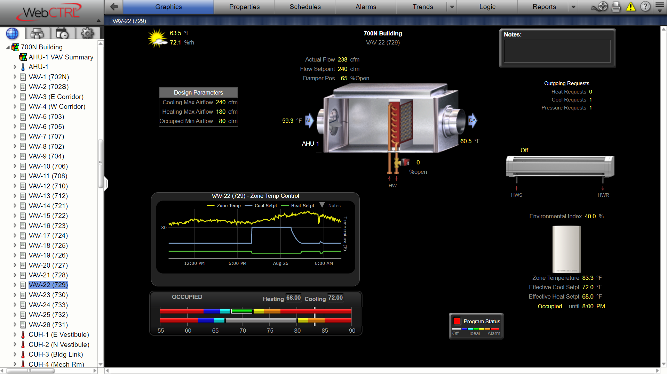

Slide 7
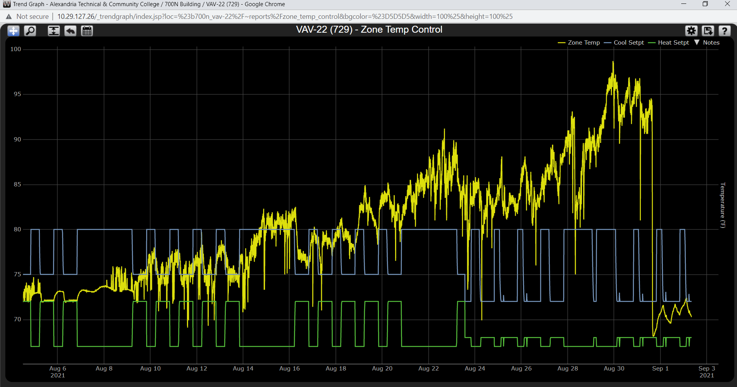

Slide 8
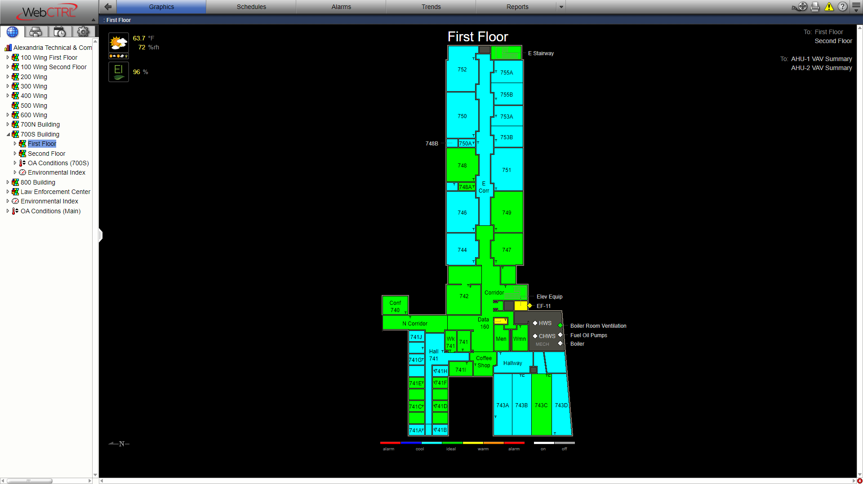
A larger area (floor or building)?

Slide 9
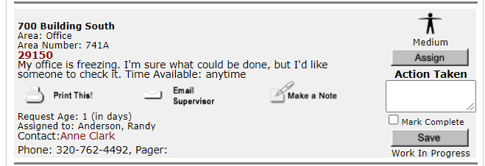
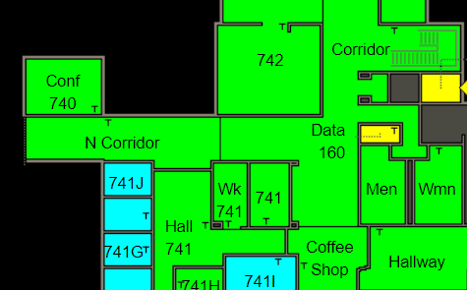
Small group of rooms

Slide 10
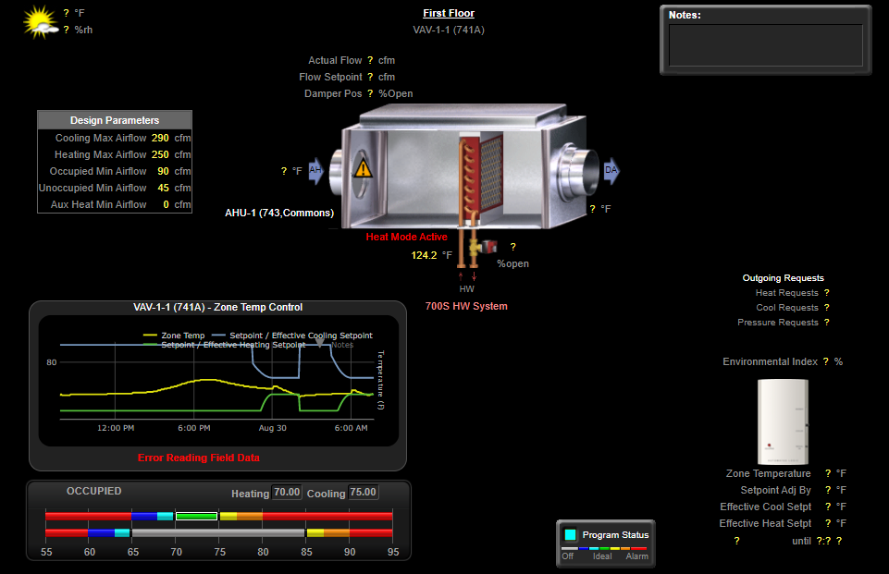
Look at VAV – Is it isolated location?
Flow air or Water, discharge temp, T-stat
Control valve stuck?
Actuator stuck
AHU Discharge temp, flow
Coil valves, dampers, RAT

Slide 11
Boiler cycling
Monitor operating graphs
Look at outside air reset
Supply and return temps
Pump speed

Slide 12
Boiler cycling switched to oil & lost BAS

Slide 14
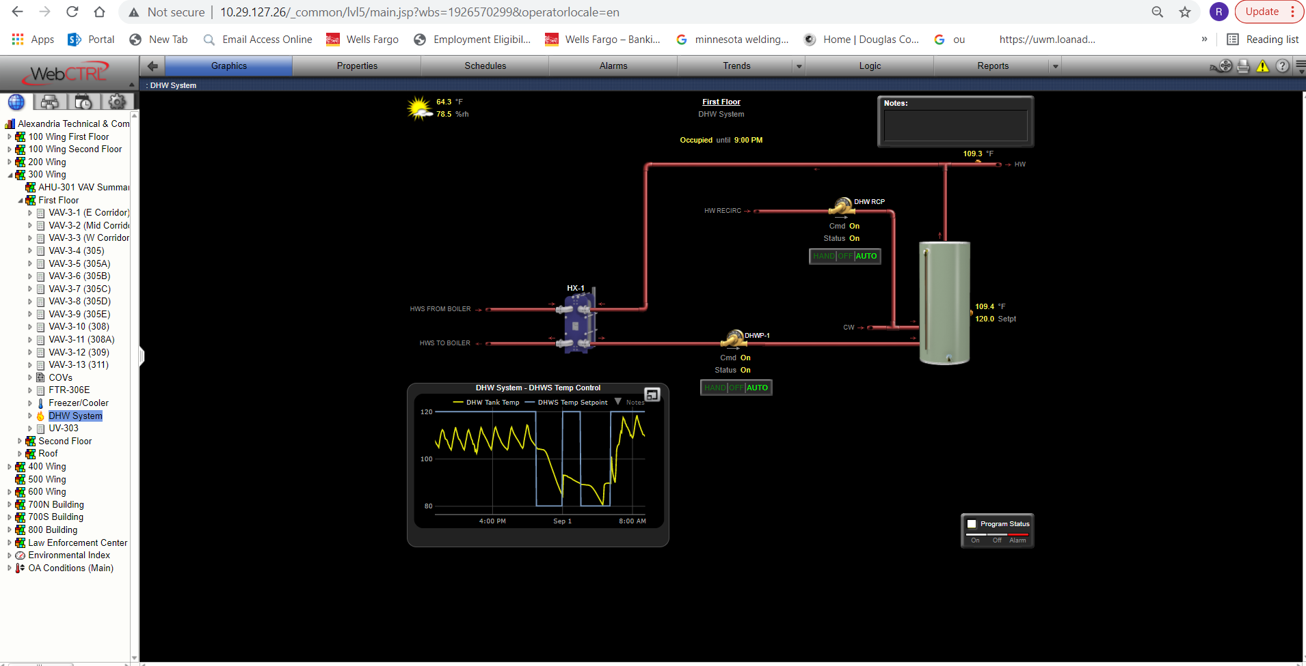
Hot water heater Replacement
Reason’s for changing to plate heat exchangers

Slide 15
AHU Issue

Slide 19
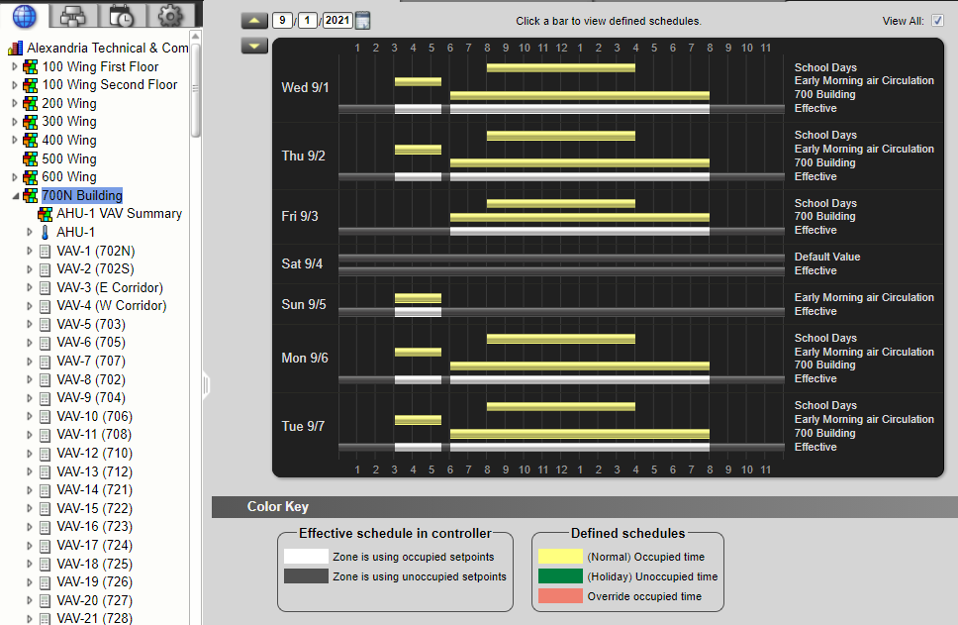
Schedules
Review scheduling and how it save energy and occ. Setback.

Slide 20
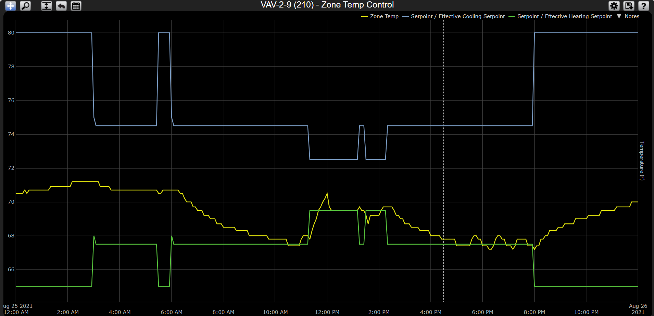

Slide 21
Questions?

