Slide 1
Behavior Based Hiring
What is it?

Slide 2
Premise: Best predictor of future behavior is past behavior

Slide 3
Behavior Based Hiring is comprised of two parts:
1. Determining who is best qualified
2. Determining who is best fit for organization

Slide 4
Determining most qualified candidates

Slide 5
Scoring Applications based upon match with qualifications/job duties

Slide 6
Must not contain:
Scoring based upon protected class status (i.e. race, ethnicity, religion)
Scoring based upon information not in Vacancy Announcement

Slide 7
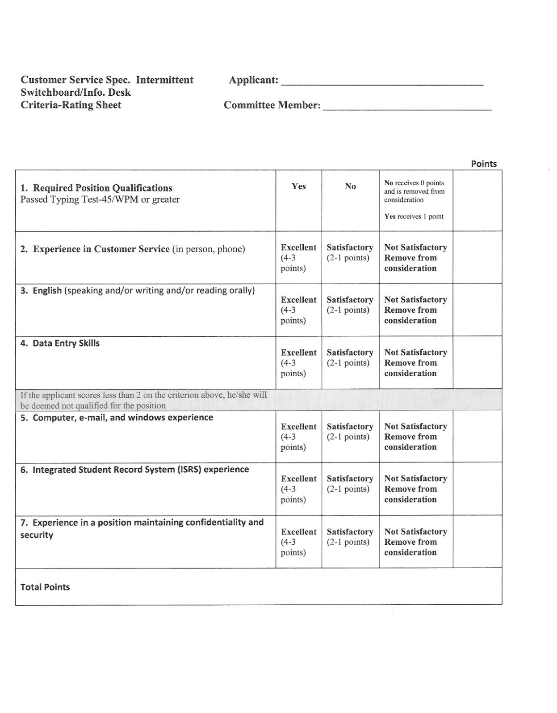

Slide 8
Top scoring applicants get invited for interview; Usually a natural break (i.e. 20, 20, 20, 19, 18, 17, 13…)

Slide 9
Interview Do’s & Don’ts

Slide 10
Interviews
Do’s:
Ask open ended questions
Ask situational questions
Ask how would you respond
What would you do if…

Slide 11
Interviews
Do’s
If a co-worker was running behind or missing deadlines for a project you needed complete by a certain date, what strategies would you use to get your work done on time?
What strategies have you used that work well in dealing with difficult people?
It is 3 p.m. and you have just completed every project you had for the day. As you are scheduled to work until 5 p.m., what would you do with this time?

Slide 12
Interviews
Don’ts:
Ask illegal questions (i.e. age, race, religion)
Ask questions that have a yes/no answer

