Slide 1
Restoring Air Side Optimization
Presenter:
Mark A. Litchke
Program Manager, Air Duct Sealing Technology
Contact Information:
Cell:(612) 327-8400
Email: mlitchke@mavo.com

Slide 2
What we will talk about today…

Slide 3
Agenda
HVAC System Inspection
HVAC System Cleaning Methodologies
Energy Savings by HVAC System Cleaning?
Summary of Findings

Slide 4
Buildings That Perform at Higher Standards Require Maintenance
High-Performance buildings were defined by Congress in 2005 as buildings that integrate and optimize all attributes, including energy conservation, safety, security, durability, accessibility, cost-benefit, productivity and sustainability considerations.
When it comes to reducing facility downtime, increasing equipment lifespan and decreasing operational costs, regular HVAC maintenance in commercial buildings is essential.

Slide 5
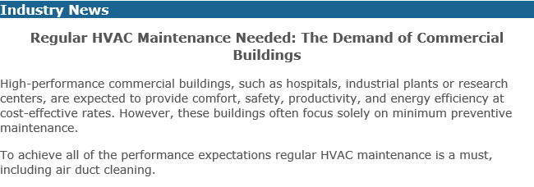
ACHR News Article

Slide 6
Agenda
HVAC System Inspection
HVAC System Cleaning Methodologies
Energy Savings by HVAC System Cleaning?
Summary of Findings

Slide 7
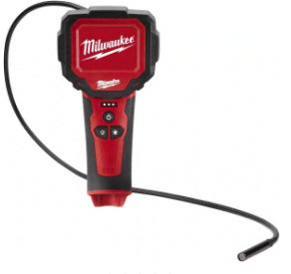
Inspection & Test Equipment

Slide 8
HVAC Component Inspection
Evaporator Coil
Damper
Heating Coil
Reheat Coil
Turning Vanes
Supply Air Outlet
Return Air Inlet
Fresh Air Intake Screen
Fan(s)
Sound Attenuator
Duct Liner
VAV Box
Condenser Coil – NOTE: Not Part of Airstream

Slide 9
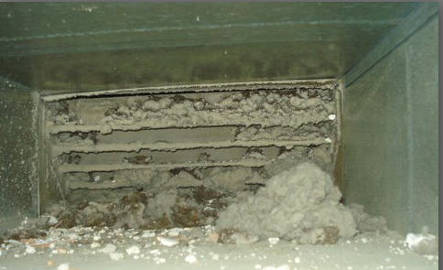
Turning Vanes

Slide 10
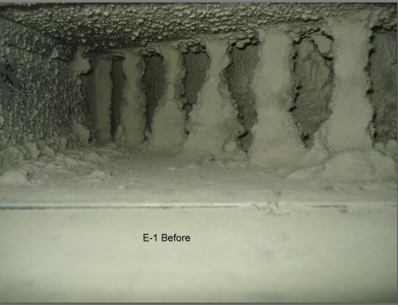
Turning Vanes

Slide 11
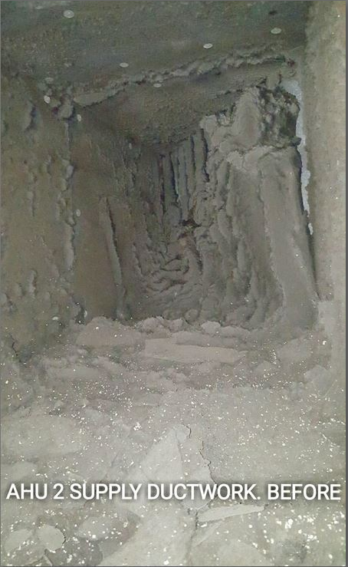
Turning Vanes

Slide 12
Turning Vanes

Slide 13
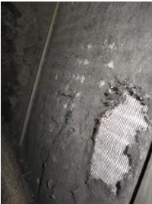
Evaporator Coils

Slide 14
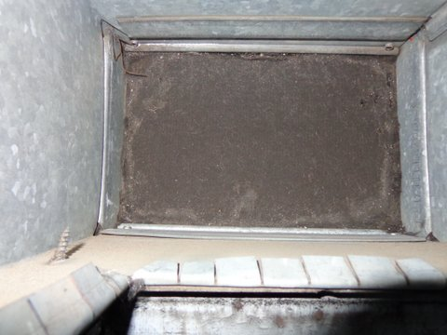
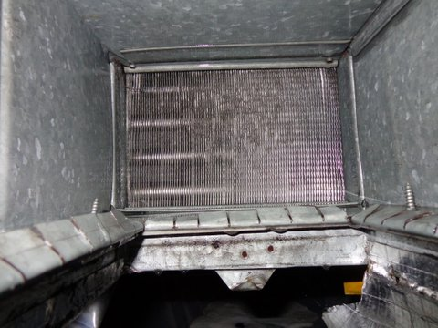
Reheat Coils

Slide 15
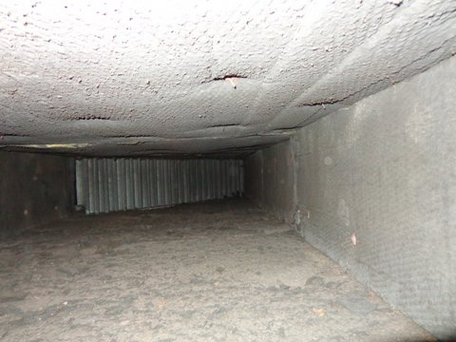
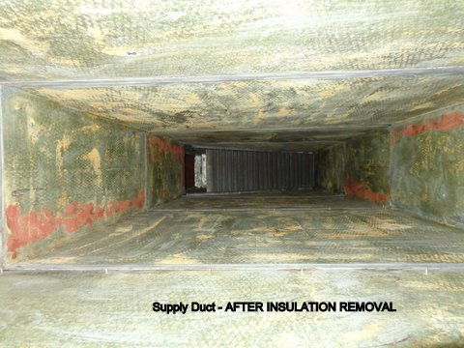
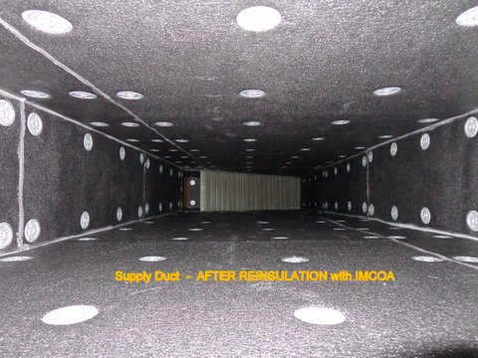
Duct Liner

Slide 16
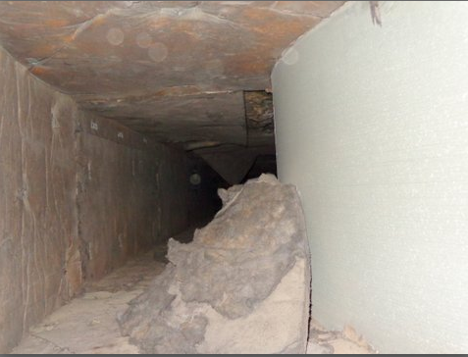
Duct Liner

Slide 17
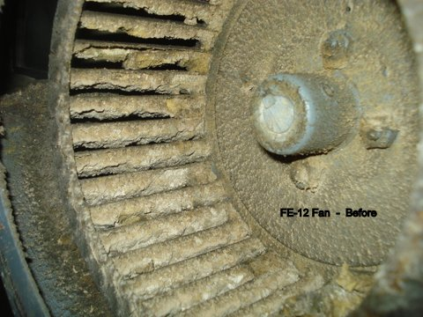
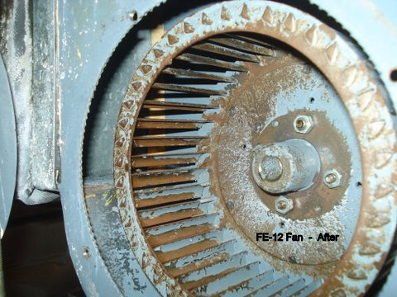
Fans

Slide 18
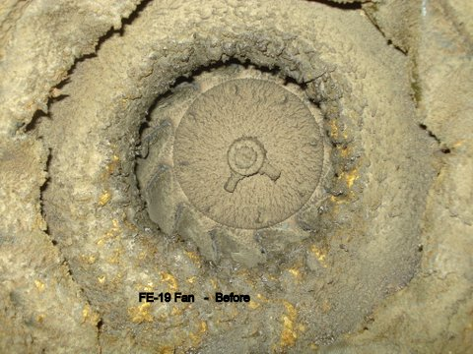
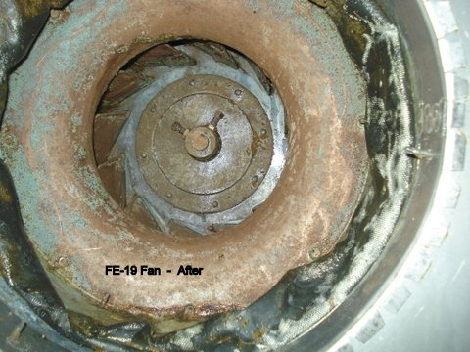
Fans

Slide 19
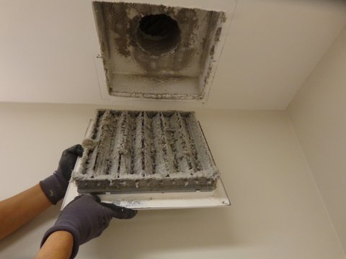
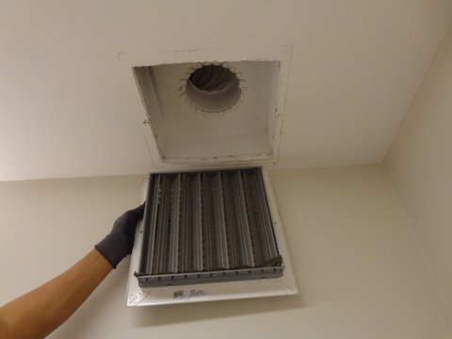
Diffusers – Grilles – Grates - Registers

Slide 20
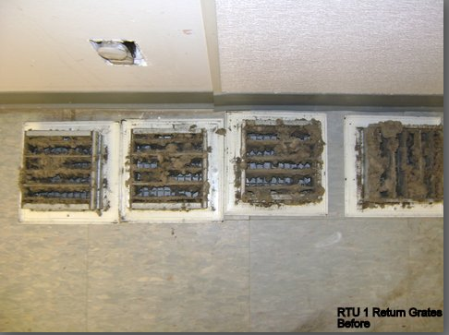
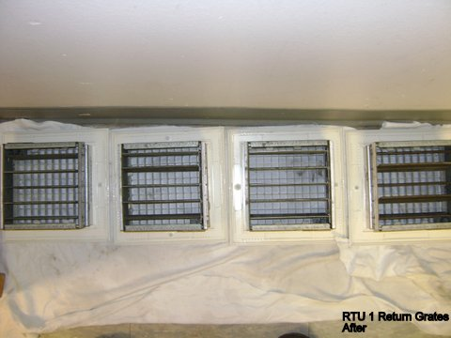
GRATES

Slide 21
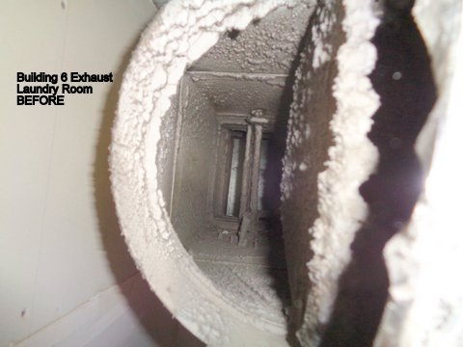
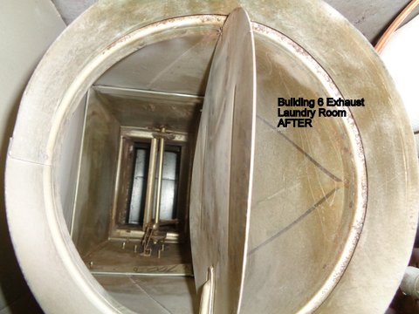
Dampers

Slide 22
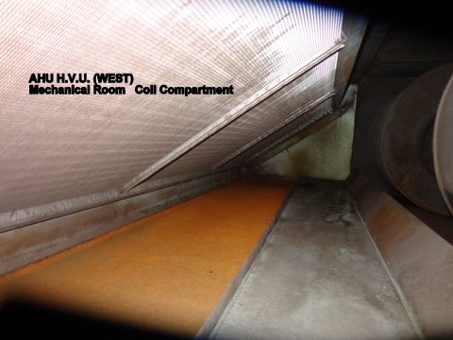
Condensate

Slide 23
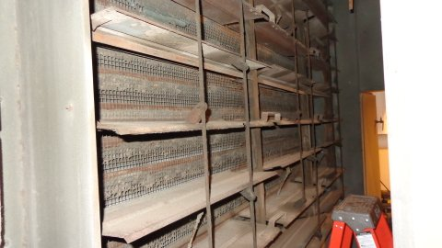
Outside Air Intake Screens

Slide 24
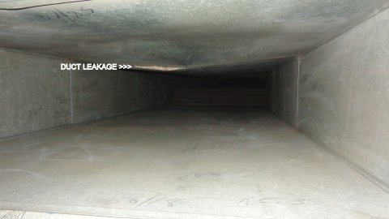
Duct Leakage

Slide 25
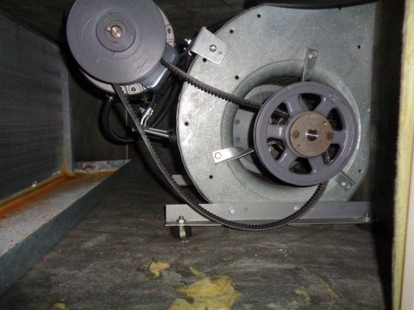
Missing or Broken Belts

Slide 26
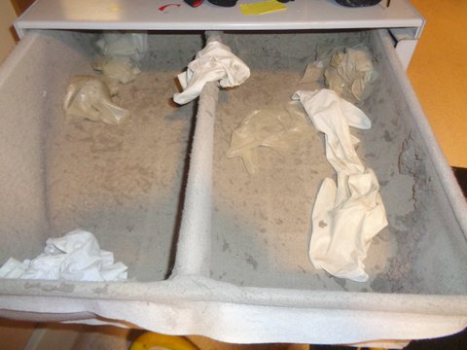
What’s in My Duct?

Slide 27
Agenda
HVAC System Inspection
HVAC System Cleaning Methodologies
Energy Savings by HVAC System Cleaning?
Summary of Findings

Slide 28
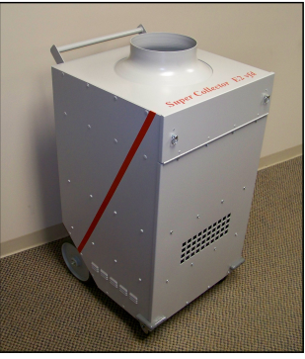
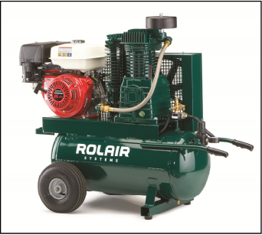
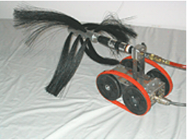
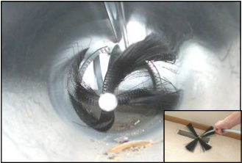
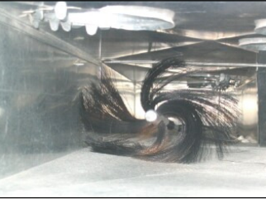
Equipment

Slide 29
Methodologies
Normal flow of air – re-energize system
HEPA filtration collection equipment – 99.97%
Negative air
Cleaning media
Source removal of contaminants
Physically enter – size & duct integrity – hand contact vacuum
Pressure washing – fans / coils / non porous surfaces

Slide 30
NADCA Certification
NADCA (National Air Duct Cleaners Association)
Established as a non profit in 1989
Providing standards / education / certification for the inspection, cleaning & restoration industry
Standards referenced in mechanical design & renovation projects

Slide 31
Agenda
HVAC System Inspection
HVAC System Cleaning Methodologies
Energy Savings by HVAC System Cleaning
Summary of Findings

Slide 32
NADCA Energy Field Trials
Temperature drop (delta t) cooling coils
Results – 5.4 degrees or 40%
CFM (cleaning of all airstream components)
Results – 54% increase in airflow
Cooling Capacity (BTU’s)
Results – 225% increase in cooling capacity
CFM (duct cleaning only)
Results – 6.9% increase in airflow

Slide 33
Case Study Results
1,373 cfm
421 cfm
421 cfm @ $5.00/cfm = $2,105.00 Annual Savings on Fan Energy - 7 yr ROI
1,373 cfm @ $5.00/cfm = $6,865.00 Annual Savings on Fan Energy- - < 1 yr ROI
Combined = 2.5 yr ROI

Slide 34
Agenda
HVAC System Inspection
HVAC System Cleaning Methodologies
Energy Savings by HVAC System Cleaning
Summary of Findings

Slide 35
Summary
Research has shown that cleaning even “lightly” fouled heating and cooling systems can result in energy savings of 11%
ASHRAE journal reported that good maintenance and operation practices, including coil cleaning can significantly improve energy efficiency and IAQ performance of the HVAC Systems 10% - 15%
The new buildings institute found that HVAC System maintenance best practices can reduce energy use by 10% - 20% across all climate zones and in contrast, poor maintenance practices can increase energy use by 30% - 60%

Slide 36
Questions?
Thank you!

