Slide 1
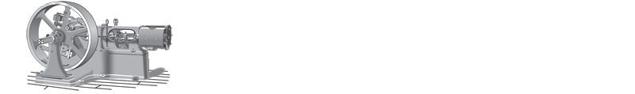
How Building Automation Systems Can Help You
“Use Your Brain to Save Your Feet”
Presented by Climate Makers Inc.

Slide 2

Today’s Track…
Footprints and Blueprints
  Types of HVAC Systems
Stepping Stones
  The Evolution of Temperature Controls
Following our Footsteps
  BAS Systems
Stepping Up Your Game
  Optimizing Your HVAC System
Q & A
  We have the Questions!
  Do YOU have the answers?!

Slide 3
Foot Notes…
Acronym / Term
Meaning
ADEC
AFDD
BAS
DCV
GUI
IoT
VAV
VFD
WMMW
Advanced Digital Economizer Controls
Advanced Fault Detection and Diagnostics
Building Automation System
Demand Control Ventilation
Graphical User Interface
Internet of Things
Variable Air Volume
Variable Frequency Drive
Wave My Magic Wand!
Notes:
ADEC is when the economizer has on-board diagnostics to let the technician know if the economizer is working properly or not.
California Title 24 is the result of a 2-year study which proved that about 80% of economizers are dysfunctional in some way and there is an energy penalty related to this, so they made ADEC mandatory in California a few years ago. It’s coming our way!

Slide 4

Let me just… “Wave My Magic Wand!”
Do you have a Magic Wand?
Would you like a Magic Wand?
Maybe now you can satisfy everyone!
Notes:
Have someone ready to hand out the magic wands!

Slide 5
Footprints and Blueprints
Rooftop Package Units
  Most Common in Commercial Buildings
Split Systems; Variable Refrigerant Flow or Volume
  VRF / VRV Becoming more popular in zoned systems
Water Source Heat Pumps
  Small to Mid-Size Office Buildings
Variable Air Volume (VAV)
  Mid-Rise, Medium Office Buildings
Chilled Water / Boiler Plants
  Schools; Campuses, Hospitals, Large Office Buildings, Mixed-Use
Notes:
Have people give “A Show of Hands” for what systems they have to get them engaged and also you get a sense of who has what types of equipment.

Slide 6
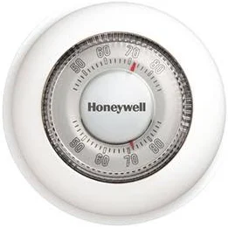
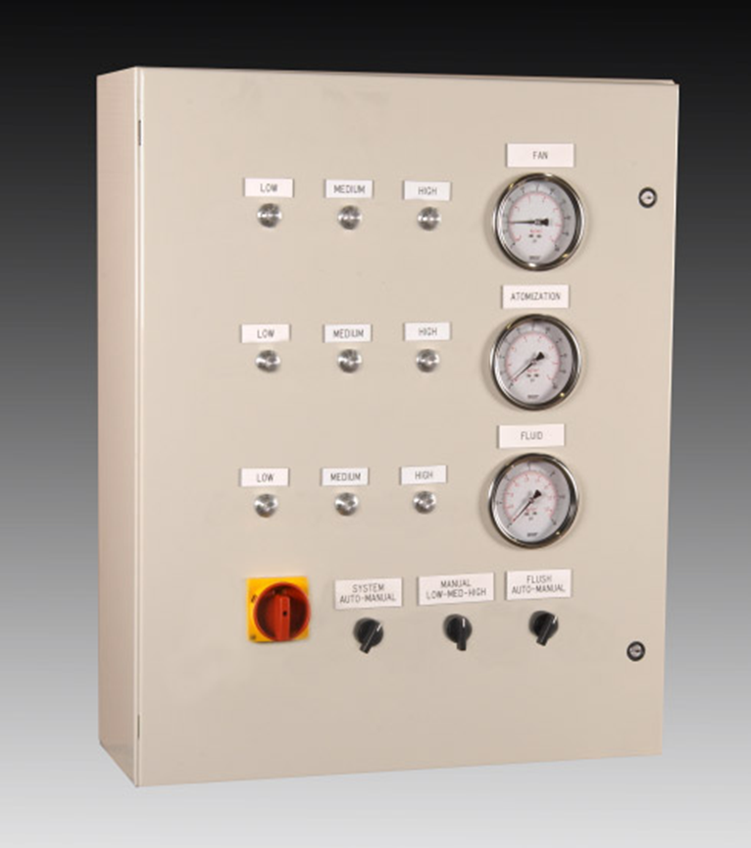
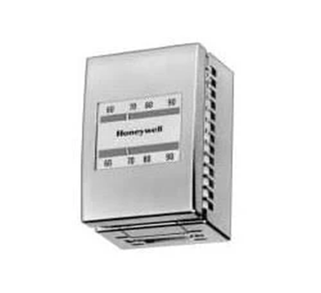
Stepping Stones
The Evolution of Temperature Control Systems
In the beginning there were Simple Thermostats
  Requires a physical presence at each component to diagnose issues.
  A lot of footsteps!
Then came Pneumatics
  Central panel analytics was the start of connected systems.
  A little more brainpower… A few less footsteps!!

Slide 7
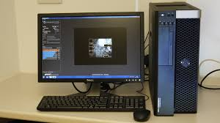
Stepping Stones
The Evolution of Temperature Control Systems
Direct Digital Controls (DDC) introduced the single workstation or “Front End”
Quite often pneumatic systems are incorporated into DDC systems
Provides a place for engineers and technicians to collect data and perform basic troubleshooting
A lot more brainpower… A lot less footsteps!

Slide 8

Stepping Stones
The Evolution of Temperature Control Systems
Web-based and mobile apps
  Brings data to you through internet devices, laptop, iPhone, etc.
  Can provide advanced fault detection and diagnostics (AFDD)
  Connected systems through the Internet of Things ( IoT )
Use Your Brain… Save Your Feet!

Slide 9

One Step at a Time…
2000 Steps / Mile
Average Pace: 3 MPH
20 Minutes / Mile
100 Steps / Minute
What’s Your Track Record?
Notes:
Ask how many people have worn a pedometer. How many miles per day were they walking on the job. Then go to next slide.

Slide 10
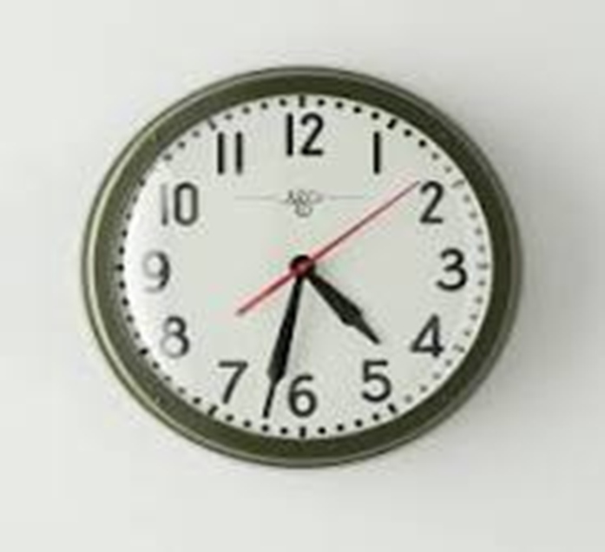
How Are You Spending Your Time?…
PROFESSION | Steps Per Hour | Steps Per Workday | Miles Per Workday | Steps Per Workyear | Miles Per Workyear | Hours Per Year | % of Workday
Lawyer | 633 | 5,064 | 2.53 | 1,129,272 | 565 | 188 | 9%
Police Officer | 663 | 5,304 | 2.65 | 1,182,792 | 591 | 197 | 10%
Nurse | 986 | 7,888 | 3.94 | 1,759,024 | 880 | 293 | 15%
Manufacturing | 989 | 7,912 | 3.96 | 1,764,376 | 882 | 294 | 15%
Facilities | 1,206 | 9,648 | 4.82 | 2,151,504 | 1,076 | 359 | 18%
Construction | 1,624 | 12,992 | 6.50 | 2,897,216 | 1,449 | 483 | 24%
Waiter / Waitress | 1,722 | 13,776 | 6.89 | 3,072,048 | 1,536 | 512 | 26%
Notes:
How many more things could you get done if you didn’t have to walk everywhere to do it? Use Your Brain and Save Your Feet!

Slide 11
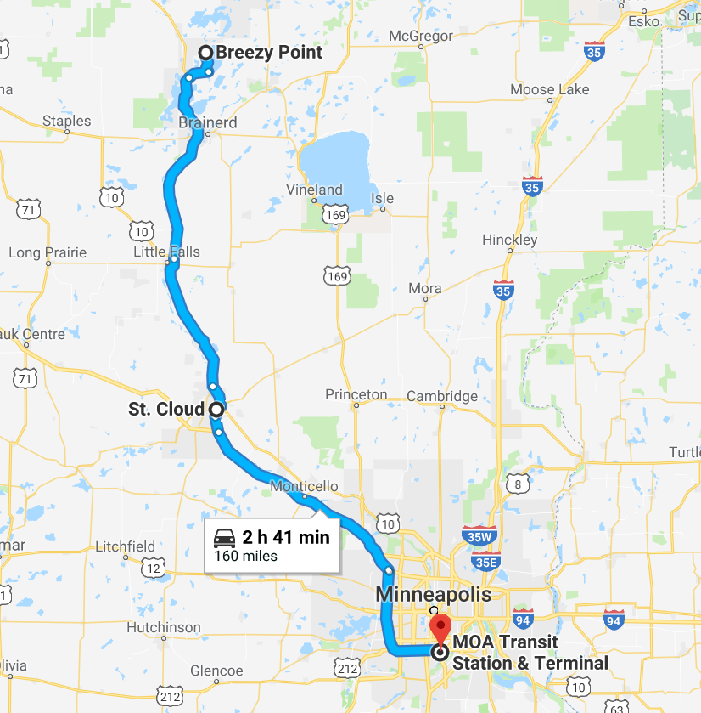
Take a Hike!
Facility Engineers steps per work year is equivalent to walking from Breezy Point to the Twin Cities 7 TIMES every year!

Slide 12
Follow in our Footsteps
Are Designed To:
Are NOT Designed To:
Maintain Operating Schedules
Collect and Display Data
Track system reliability for:
  System costs and budget forecasting
  Maintaining system and facility records
Prompt users to take appropriate actions
Use your brain to save your feet!
Compensate for poorly designed system HVAC systems
Fix the problem for you
Replace the human brain
Solve problems by WMMW “Waving My Magic Wand”
  …but you can try!

Slide 13
Components of the BAS
Inputs / Outputs
Trends / Alarms
Network
Graphical User Interface
Controllers

Slide 14
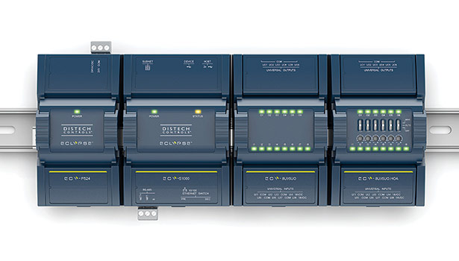
Controllers: Where HVAC Comes Alive!
Inputs and Outputs Report to the Controller
Resolves the questions asked during programming:
  “When this happens; Make that happen”
Be mindful of any changes to the spaces being served that may alter the original sequence of operations

Slide 15
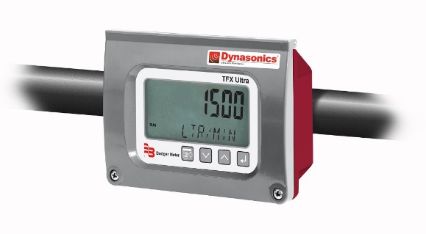
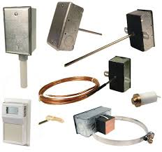
Sensors: Investigators for the BAS system
Sensors report information such as flow, pressures, temperatures, and humidity to the Controller, so the Controller can formulate the appropriate response and satisfy the controlled medium.
More sensors gives your BAS:
More flexibility
More complexity
More programming options
More trending and alarm options
More cost
Ask your controls provider to help you strike the right balance between wants, needs, and cost

Slide 16
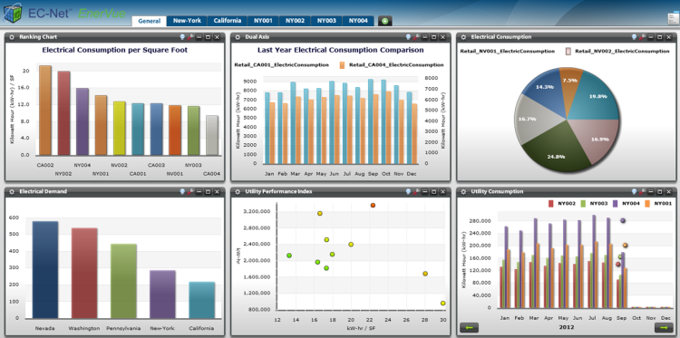
Trends and Alarms
Trending and Alarm Reports help the system operator:
  Capture live and historical data of system operation and performance
  Help troubleshoot problematic areas
  Help maintain records of system performance and actions taken

Slide 17

Graphical User Interface (GUI)
Provides visual access to the system for status, trends, AFDD etc.
Provides a learning opportunity for end-users to better understand the software and mechanical equipment.
Not all devices interface with BAS
Everyone Loves “Good” Graphics!
(Keep Them Simple and Meaningful)

Slide 18
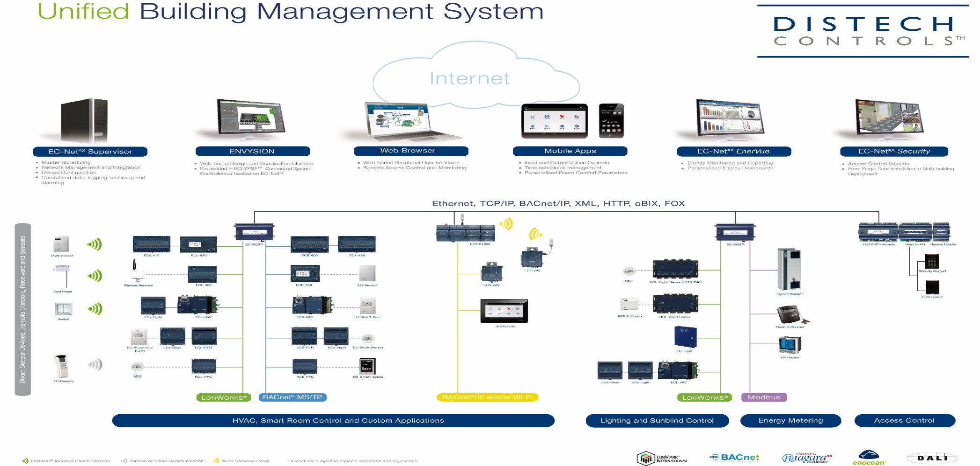
Stepping Up Your Game and Optimizing Your System!

Slide 19
Stepping Up Your Game
Most Common Challenges
Maintaining a schedule that works for “everyone”
Satisfying the “comfort zone” of various people
Energy reduction goals
Outdated systems “Can’t do what I’d like it to do”
Is the juice worth the squeeze
  When is it time to upgrade my systems?

Slide 20
Stepping Up Your Game
Scheduling – The #1 Game Changer
Run Hours are the #1 Factor in Energy Savings Equations
  Run equipment only when it is needed
Night Setback / Setup
  Setpoints are changed automatically
  Boiler/Chiller water temp is often overlooked
Optimized Start / Stop
Manage holidays and vacation schedules automatically
Common Complaints Related to Scheduling:
  Staff working early/late
  Activities in Gymnasiums, Auditoriums, etc.
  Manage their expectations (WMMW if needed!)
Notes:
(Boiler / Chiller Water overlooked…): People set back their space thermostats but leave the boiler operator at the same temperature. Sometimes the boiler cycles overnight for no reason.

Slide 21
Stepping Up Your Game
Air System Setpoint Adjustments
VAV Systems:
  Reset Discharge Air Temperature
    Typically set to 55 degrees for cooling needs
    May be able to set at 60 to 65 degrees in winter months
AHUs and RTUs:
  DCV can reduce outside air requirements
  Advanced Digital Economizer Controls (ADEC)
    Integrated Cooling
    California Title 24

Slide 22
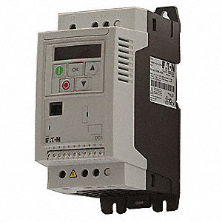
Stepping Up Your Game Application of VFD’s
One of the most common energy saving applications in HVAC systems
  Water and Air Systems
Reduces wear of many components.
  Soft starting motors
Speed of VFD can be an indicator of opportunity to adjust boiler water temperature.
Pay special attention to ventilation requirements when applied to air systems; AHU’s RTU’s etc.
Energy Savings Follow the Fan Affinity Laws:
Motor Speed Energy Savings
90% 27%
75% 50%
40% 92%
Notes:
When slowing fan speeds you must also increase the opening of the OA Damper in order to maintain the proper volume of outside air for ventilation.

Slide 23
Stepping Up Your Game
Boiler Setpoint Adjustments
Headband
  The range of water temperature the boiler maintains
  Especially important:
    If boiler is oversized, and
    During light load conditions
  Longer runtimes / heating cycles equate to:
    Less wear and tear on the boiler
    Higher Efficiency
    Starting the boiler is one of the most stressful thing you can do to it
  Note: Boiler setpoints typically not available for remote adjustment

Slide 24
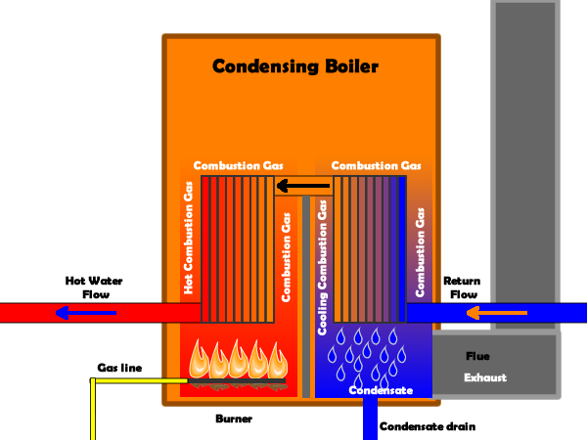
Stepping Up Your Game
Condensing Boilers
By taking an “extra pass” through a secondary heat exchanger, the flue gas reaches condensing temperatures. This is called “Latent Heat”. Nearly 1000 times more BTU’s are transferred per pound to the boiler water than in the primary heat exchanger.

Slide 25
Stepping Up Your Game
Does this make “Cents?” (No - It makes Dollars!!) ☺
Example of a 1MBTU / Hour Boiler
Input | Efficiency | Output | Wasted BTUs
1,000,000 | 80% | 800,000 | 200,000
1,000,000 | 97% | 970,000 | 30,000
Net Gain | 17% | 170,000
This Condensing Boiler is 17% more efficient, which equates to an additional 170,000 BTU/Hour being transferred to the boiler water instead of going up the stack!

Slide 26
Questions and Answers!
We Have The Questions…
Do You Have The Answers?

Slide 27
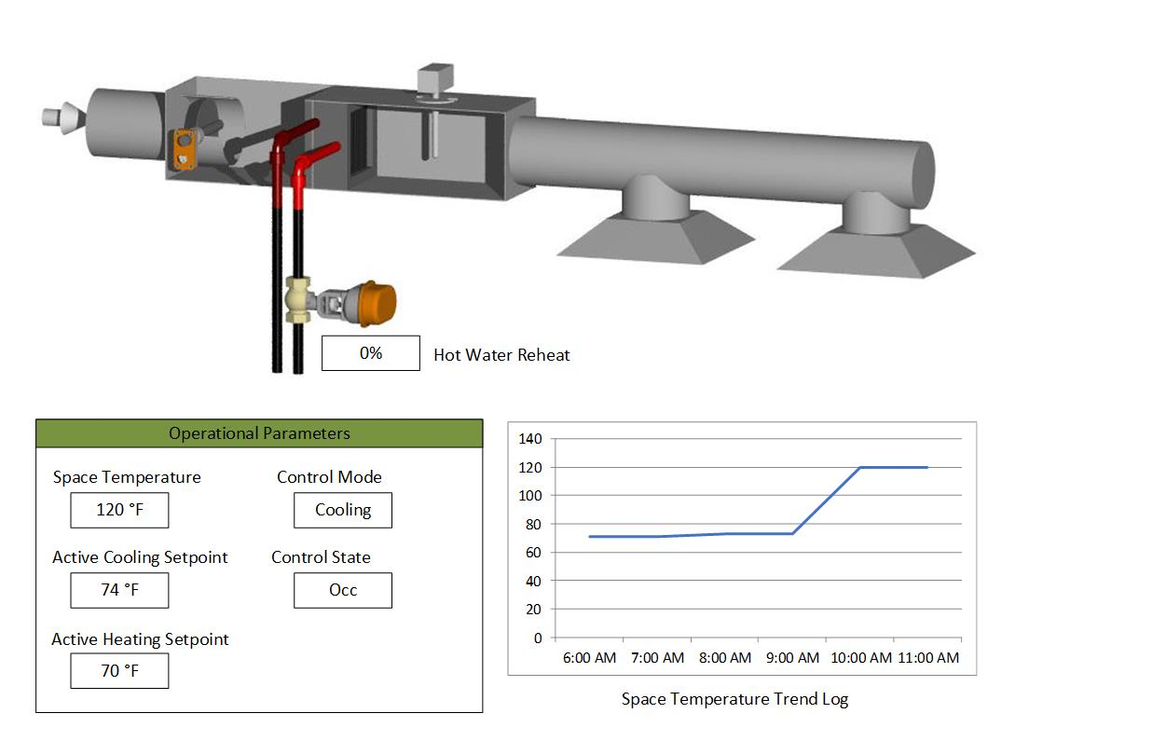
System: VAV with Hot Water Reheat
11:00 AM: No Heat In Cafeteria
BAS GUI View:
BAS Indicates:
Boiler operations are normal
Boiler pumps are circulating
Heat Valve is closed
Space temp reads 120 degrees
  Trend space temp was normal until 10:00am then sharply increased
What could the problem be?

Slide 28
System: VAV with Hot Water Reheat
11:00am: No Heat In Cafeteria
BAS GUI View:
Conditions Found / Actions:
Portable coffee pot was inadvertently placed under the space sensor in the cafeteria. The heat it produced told the space sensor to close the heat valve and allow 55 degree air to pass and cool the space. Now the space is over cooled!
Action:
Move the coffee pot!
Note to Self:
It’s not always a system problem!

Slide 29
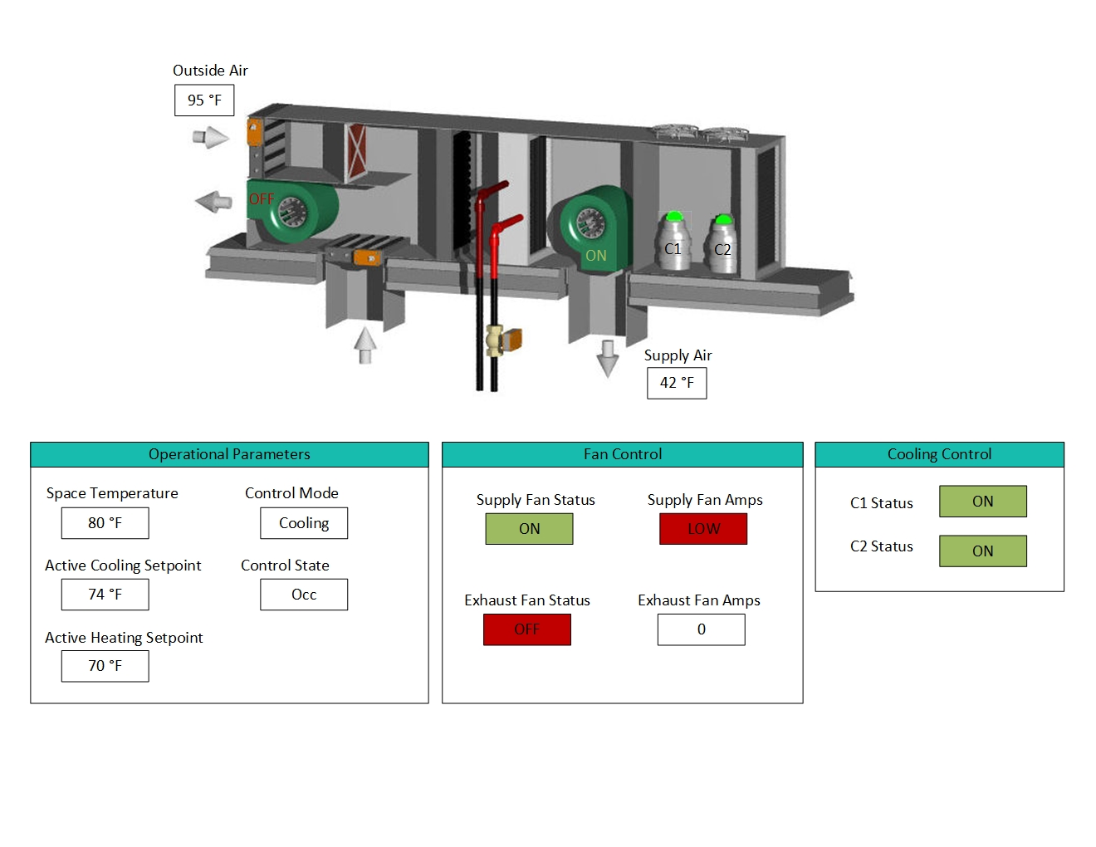
System: Rooftop Package Unit
July 4th - No Cooling
BAS GUI View:
BAS Indicates:
Space temp reading is 80 degrees
OA Temp is 95 degrees
Both compressors are running
Indoor blower status is “ON”
Fan amps are lower than normal
Supply air temp is 42 degrees
What could the problem be?

Slide 30
System: Rooftop Package Unit
July 4th – No Cooling
BAS GUI View:
Conditions Found / Actions:
Helium balloons in space got sucked up into the return air grill, which restricted air flow and caused the cooling coil to ice up.
Actions:
Remove balloons from return air grill. Turn off unit, thaw the coil, and check unit operations.
Incorporate AFDD programming to protect the compressors and other system components.

Slide 31
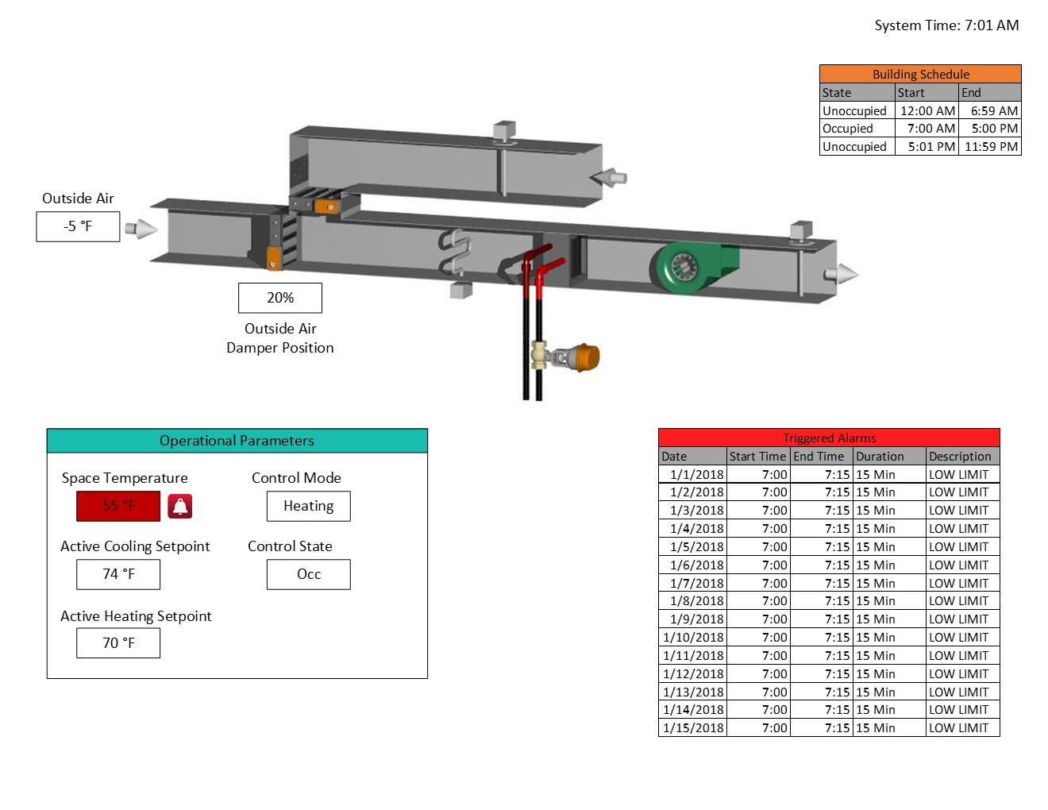
System: Constant Volume AHU
Jan 15th - Low Limit Alarm
BAS GUI View:
BAS Indicates:
Building schedule is occupied from 7:00am until 5:00pm
Trend log shows low limit alarm from 7:00 until 7:15am every morning since outside air temps dropped below zero
  Then alarm clears itself
Outside air damper position is closed when unoccupied and at 20% open during occupied hours
What could the problem be?

Slide 32
System: Constant Volume AHU
Jan. 15th Low Limit Alarm
BAS GUI View:
Conditions Found / Actions:
The key to understanding this alarm condition is “what happens at 7:00am”
The system changes over to occupied setpoints, but the controls do not employ the optimum start function; thus, the outside air dampers open 20% right away and it takes the system 15 minutes for the supply air temperature to rise above the low limit setpoint.
Action:
Install controls with optimum start function
Note to Self:
Do your best to eliminate nuisance alarms!

Slide 33
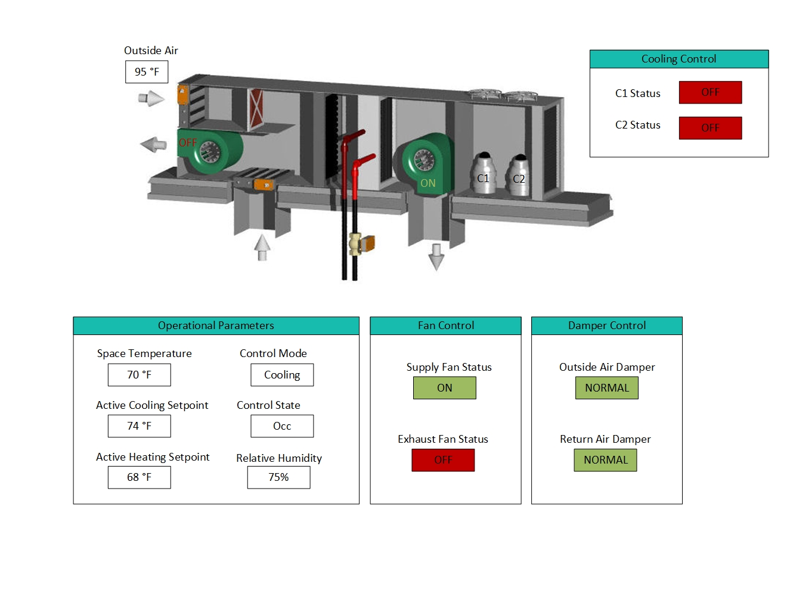
System: Multiple RTUs
July 25th Building Feels “Clammy”
BAS GUI View:
BAS Indicates:
Space temp is satisfied at 70 degrees
  Compressors are off
OA Temp is 95 degrees
OA Relative humidity is 75%
OA Damper position is normal
Indoor blower status is “ON”
  Fan amps are normal
Trend log shows:
  Shorter than normal run cycles when compared to previous years
  LED Lighting upgrade was implemented last winter throughout facility
What could the problem be?

Slide 34
System: Multiple RTUs
July 25th Building Feels “Clammy”
BAS GUI View:
Conditions Found / Actions:
The key to understanding this condition is in the Trend Log to realize “what else changed in the building that could contribute to this condition”.
The “unintended consequence” of lighting upgrades is they quite often remove some of the heat load the units were designed for. Thus, the compressors do not run long enough to properly dehumidify.
Possible Action:
Adding a VFD with the proper fan speed sequence to the supply fan can assist in the removal up to 8% more relative humidity to help counter this condition.

Slide 35
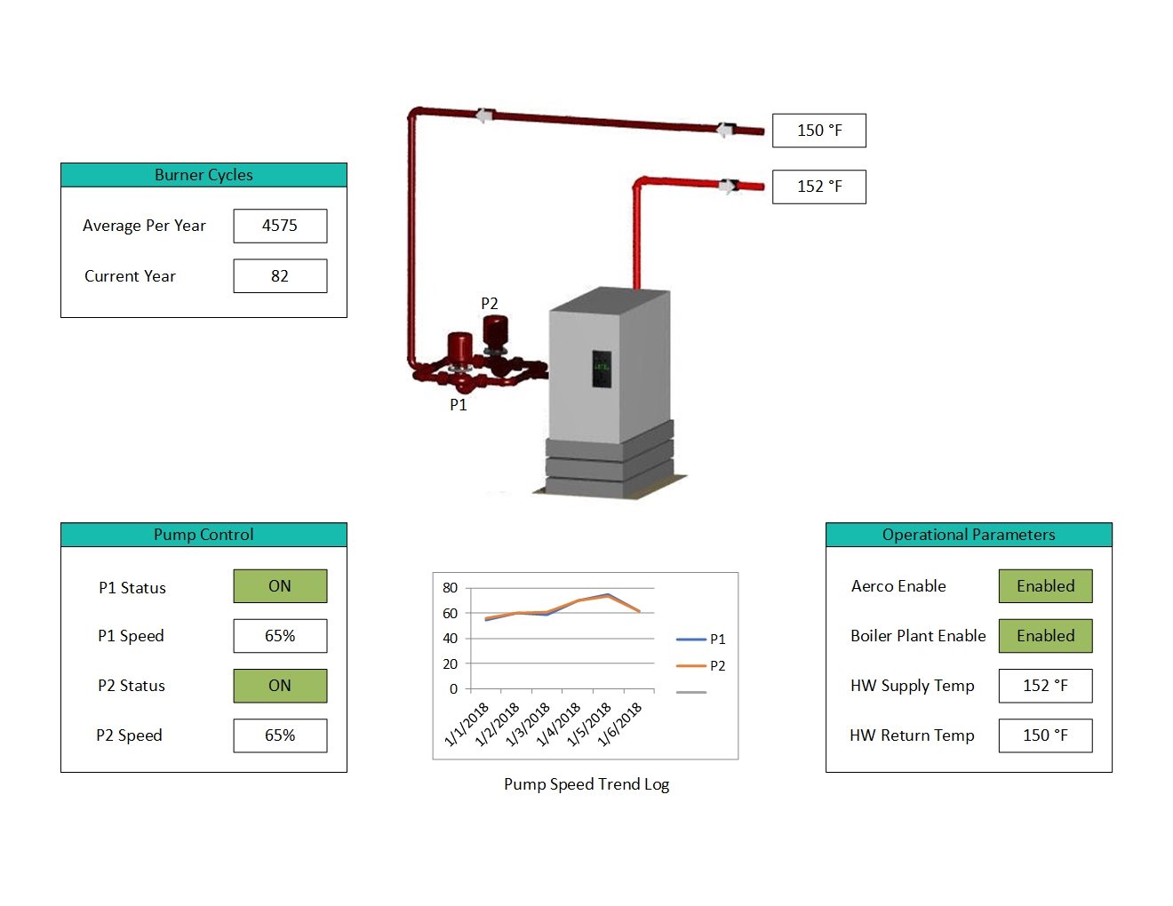
System: Condensing Boiler
7 Year Old Boiler Need Replacing
BAS GUI View:
BAS Indicates:
Supply water temperatures consistently between 140 and 180 degrees
Secondary pumps consistently run between 50% and 75% speed
Average # of burner cycles per year is 4,575
What could the problem be?

Slide 36
System: Condensing Boiler
7 Year Old Boiler Need Replacing
BAS GUI View:
Conditions Found / Actions:
This client bought a condensing boiler, but it was never set up properly to operated as one. Thus:
The boiler water temp was always too high
The boiler never condensed, so the client did not receive the energy benefits they expected
The boiler short cycled as evidence of the high burner cycles
The building operator didn’t care enough to notice for the past 7 years and was terminated!
Action:
Be a life learner!
Stay curious and ask questions about the ever-changing technologies in our industry!
Seek professional help when needed!

Slide 37
Step up your game and optimize your system by:
Evaluate and adjust your system schedules
Evaluate and adjust setpoints, such as:
  Operating temperatures
  Night setback temperatures
    Space Temperatures and Boiler Water Temperature
  Outside Air Reset Schedule
  Flow rates
Take the time to understand your BAS. It can help you
“Use Your Brain to Save Your Feet”

Slide 38
If All Else Fails…
Wave Your Magic Wand!
THANK YOU!
Contact Lori Baur at Climate Makers lorib@climatemakersinc.com 1-800-773-9084
Notes:
Have everyone wave their magic wand!

